Slide 1
The Economics of Money, Banking, and Financial Markets
Twelfth Edition, Global Edition
Chapter 3
What Is Money?
Copyright © 2019 Pearson Education, Ltd.
Notes:
If this PowerPoint presentation contains mathematical equations, you may need to check that your computer has the following installed:
1) MathType Plugin
2) Math Player (free versions available)
3) NVDA Reader (free versions available)

Slide 2
Preview
In this chapter, we develop precise definitions by exploring the functions of money, looking at why and how it promotes economic efficiency, tracing how its forms have evolved over time, and examining how money is currently measured.

Slide 3
Learning Objectives
Describe what money is
List and summarize the functions of money
Identify different types of payment systems
Compare and contrast the M1 and M2 money supplies

Slide 4
Meaning of Money (1 of 2)
Money (or the “money supply”): anything that is generally accepted as payment for goods or services or in the repayment of debts.
A broad definition

Slide 5
Meaning of Money (2 of 2)
Money (a stock concept) is different from:
Wealth: the total collection of pieces of property that serve to store value
Income: flow of earnings per unit of time (a flow concept)

Slide 6
Functions of Money (1 of 2)
Medium of Exchange:
Eliminates the trouble of finding a double coincidence of needs (reduces transaction costs)
Promotes specialization
A medium of exchange must:
be easily standardized
be widely accepted
be divisible
be easy to carry
not deteriorate quickly

Slide 7
Functions of Money (2 of 2)
Unit of Account:
Used to measure value in the economy
Reduces transaction costs
Store of Value:
Used to save purchasing power over time.
Other assets also serve this function.
Money is the most liquid of all assets but loses value during inflation.

Slide 8
Evolution of the Payments System (1 of 2)
Commodity Money: valuable, easily standardized, and divisible commodities (e.g. precious metals, cigarettes)
shortcomings: heavy and uneasy to transport from one place to another
Fiat Money: paper money decreed by governments as legal tender (can be accepted as legal payment for debts)
features: It is no longer backed by a physical commodity and its value depends on market demand and supply

Slide 9
Evolution of the Payments System (2 of 2)
Checks: an instruction to your bank to transfer money from your account
Electronic Payment (e.g. online bill pay)
E-Money (electronic money):
Debit card
Stored-value card (smart card)
E-cash

Slide 10
Are We Headed for a Cashless Society?
Predictions of a cashless society have been around for decades, but they have not come to fruition.
Although e-money might be more convenient and efficient than a payments system based on paper, several factors work against the disappearance of the paper system.
However, the use of e-money will likely still increase in the future.

Slide 11
Will Bitcoin Become the Money of the Future?
Bitcoin is a type of electronic money created in 2009.
By “mining,” Bitcoin is created by decentralized users when they use their computing power to verify and process transactions.
Although Bitcoin functions as a medium of exchange, it is unlikely to become the money of the future because it performs less well as a unit of account and a store of value.

Slide 12
Measuring Money (1 of 2)
How do we measure money? Which particular assets can be called “money”?
Construct monetary aggregates using the concept of liquidity:
M1 (most liquid assets) = currency + traveler’s checks + demand deposits + other checkable deposits

Slide 13
Measuring Money (2 of 2)
M2 (adds to M1 other assets that are not so liquid) = M1 + small denomination time deposits + savings deposits and money market deposit accounts + money market mutual fund shares

Slide 14
The Federal Reserve’s Monetary Aggregates (1 of 3)
Table 1 Measures of the Monetary Aggregates
Blank | Value as of July 3, 2017 ($ billions)
M1 = Currency | 1,481.5
+ Traveler’s checks | 2.0
+ Demand deposits | 1,501.5
+ Other checkable deposits | 574.8
Total M1 | 3,559.8
M2 = M1 | Blank
+ Small-denomination time deposits | 357.7
+ Savings deposits and money market deposit accounts | 8,923.9
+ Money market mutual fund shares (retail) | 673.7
Total M2 | 13,515.1
Source: Federal Reserve Statistical Release, H.6, Money Stock Measures: https://www.federalreserve.gov/releases/H6/current.

Slide 15
The Federal Reserve’s Monetary Aggregates (2 of 3)

Slide 16
The Federal Reserve’s Monetary Aggregates (3 of 3)
M1 versus M2: Does it matter which measure of money is considered?
M1 and M2 can move in different directions in the short run (see figure).
Conclusion: the choice of monetary aggregate is important for policymakers.

Slide 17
Where Are All the U.S. Dollars?
The more than $4,500 of U.S. currency held per person in the United States is a surprisingly large number.
Where are all these dollars and who is holding them?
Criminals
Foreigners

Slide 18
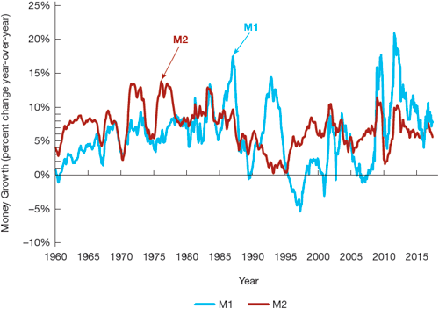
Figure 1 Growth Rates of the M1 and M2 Aggregates, 1960–2017
Source: Federal Reserve Bank of St. Louis, FRED database: http://research.stlouisfed.org/fred2

Slide 19
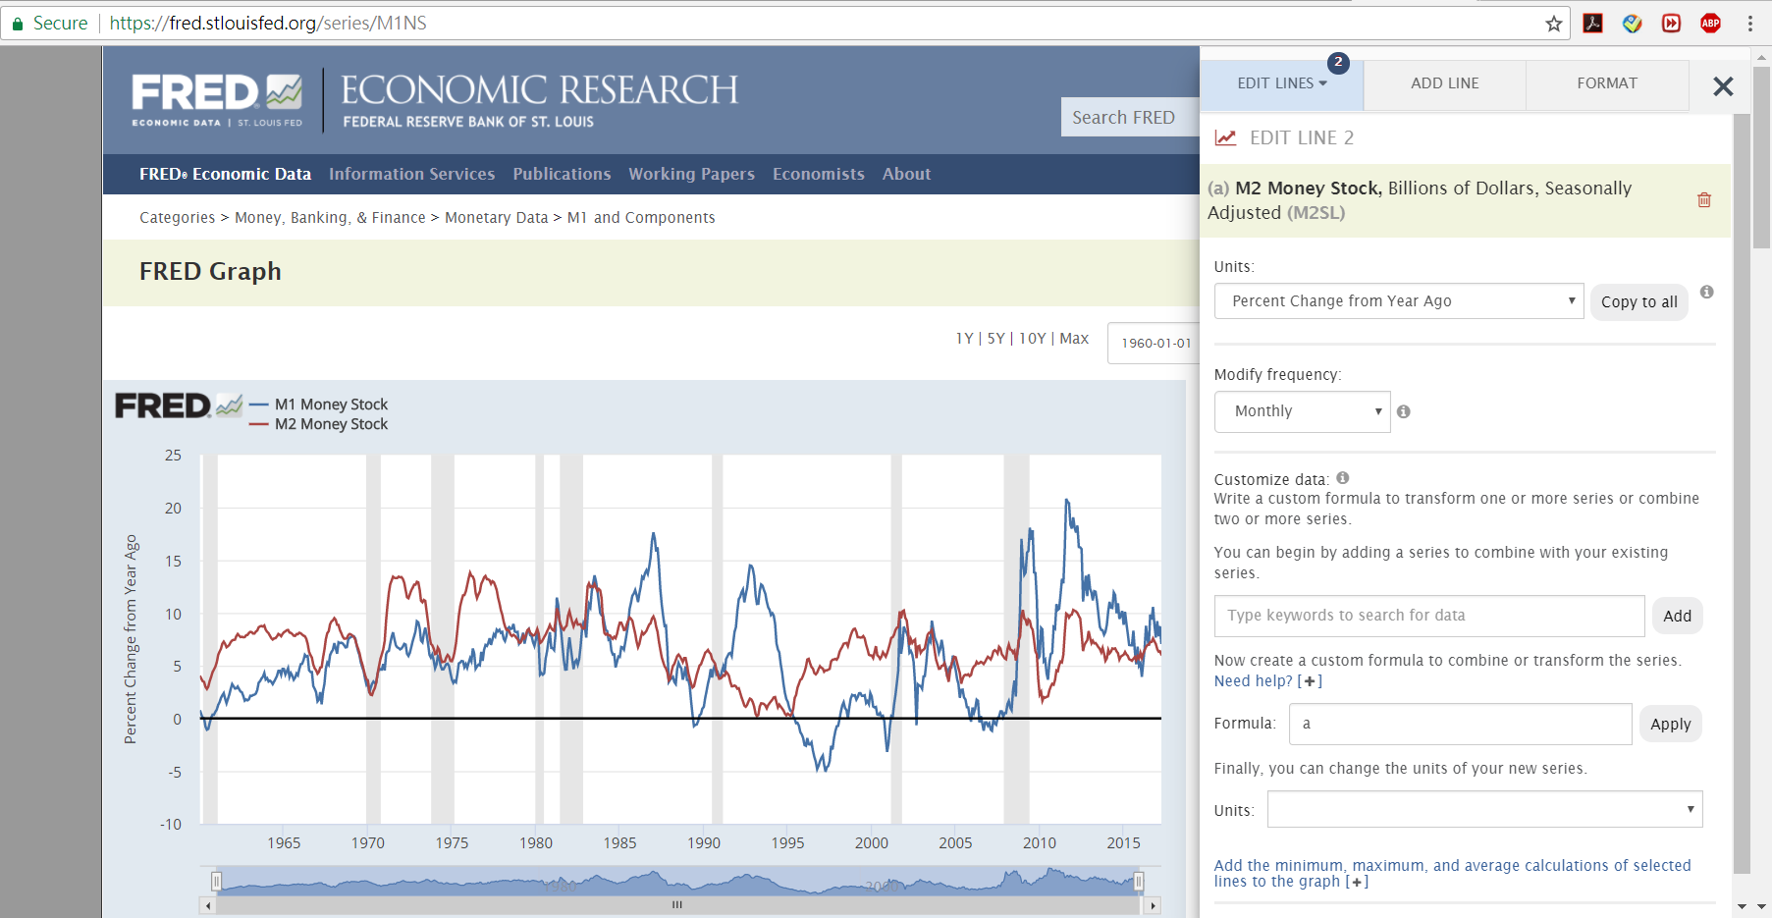
Use FRED Database
Source: Federal Reserve Bank of St. Louis, FRED database: http://research.stlouisfed.org/fred2

