Slide 1
The Economics of Money, Banking, and Financial Markets
Twelfth Edition, Global Edition
Chapter 12
Financial Crises in Advanced Economies
Copyright © 2019 Pearson Education, Ltd.
Notes:
If this PowerPoint presentation contains mathematical equations, you may need to check that your computer has the following installed:
1) MathType Plugin
2) Math Player (free versions available)
3) NVDA Reader (free versions available)

Slide 2
Preview
This chapter makes use of agency theory, the economic analysis of the effects of asymmetric information (adverse selection and moral hazard) on financial markets, to see why financial crises occur and why they have such devastating effects on the economy.
It then applies our analysis to explain the course of events that led to a number of past financial crises, including the most recent global financial crisis.

Slide 3
Learning Objectives
Define the term “financial crisis.”
Identify the key features of the three stages of a financial crisis.
Describe the causes and consequences of the global financial crisis of 2007–2009.
Summarize the changes to financial regulation that developed in response to the global financial crisis of 2007–2009.
Identify the gaps in current financial regulation and how they might be addressed with future regulatory changes.

Slide 4
Global: The European Sovereign Debt Crisis
The increase in budget deficits that followed the financial crash of 2007–2009 led to fears of government defaults and a surge in interest rates.
The sovereign debt crisis, which began in Greece, moved on to Ireland, Portugal, Spain, and Italy.
The stresses created by this and related events continue to threaten the viability of the euro.

Slide 5
What Is a Financial Crisis?
A financial crisis occurs when there is a particularly large disruption to information flows in financial markets, with the result that financial frictions increase sharply and financial markets stop functioning.

Slide 6
Dynamics of Financial Crises
Stage One: Initiation of a Financial Crisis
Credit Boom and Bust: Mismanagement of financial liberalization/innovation drives down the net worth of banks and triggers the deleveraging process
Asset-price Boom and Bust
As the asset-price bubble burst, the net worth of companies declines, encouraging firms to make riskier investment
Increase in Uncertainty

Slide 7
Dynamics of Financial Crises
Stage two: Banking Crisis
Deteriorating balance sheets may lead financial institutions into insolvency
Savers withdraw their deposits and banks sell off assets to raise necessary funds
The fire sales cause asset prices to drop again and more banks to fail
Stage three: Debt Deflation
As debt payments are fixed in nominal terms, an unanticipated decline in price level will raise the burden of the debt in real terms

Slide 8
Bank panics: A frequent occurrence
Country | Number of banking crises since independence or 1800 | Number of banking crises since 1945 | Share of years in a banking crisis since independence or 1800
Argentina | 9 | 4 | 8.8
Brazil | 11 | 3 | 9.1
Canada | 8 | 1 | 8.5
China | 10 | 1 | 9.1
France | 15 | 1 | 11.5
Germany | 8 | 2 | 6.2
Japan | 8 | 2 | 8.1
Russia | 2 | 2 | 1.0
South Africa | 6 | 2 | 6.3
United Kingdom | 12 | 4 | 9.2
United States | 13 | 2 | 13.0
Source: Adapted from Reinhart, Carmen M. and Kenneth Rogoff (2009), This Time is Different: Eight Centuries of Financial Folly, Princeton, NJ: Princeton University Press.

Slide 9
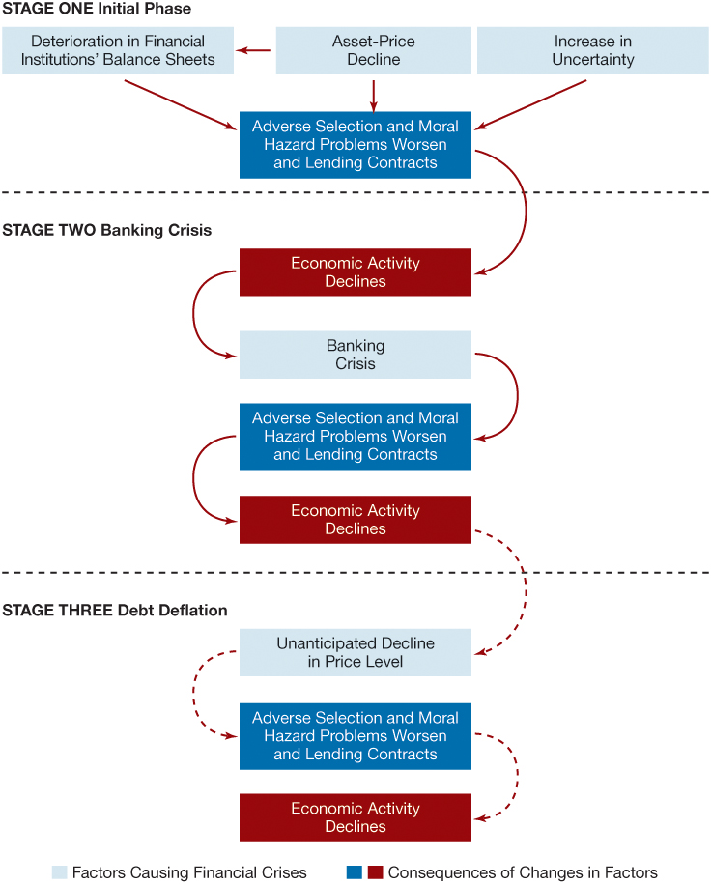
Figure 1 Sequence of Events in Financial Crises in Advanced Economies

Slide 10
The Mother of All Financial Crises: The Great Depression
How did a financial crisis unfold during the Great Depression and how it led to the worst economic downturn in the history of the United States and other advanced economies?
This event was brought on by:
Stock market crash
Bank panics
Continuing decline in stock prices
Debt deflation

Slide 11
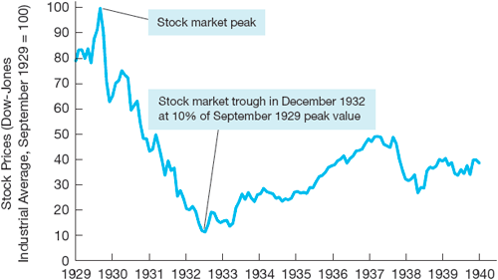
Figure 2 Stock Price Data During the Great Depression Period
Source: Dow-Jones Industrial Average (DJIA). Global Financial Data: http://www.globalfinancialdata.com/index_tabs.php?action=detailedinfo&id=1165 .

Slide 12
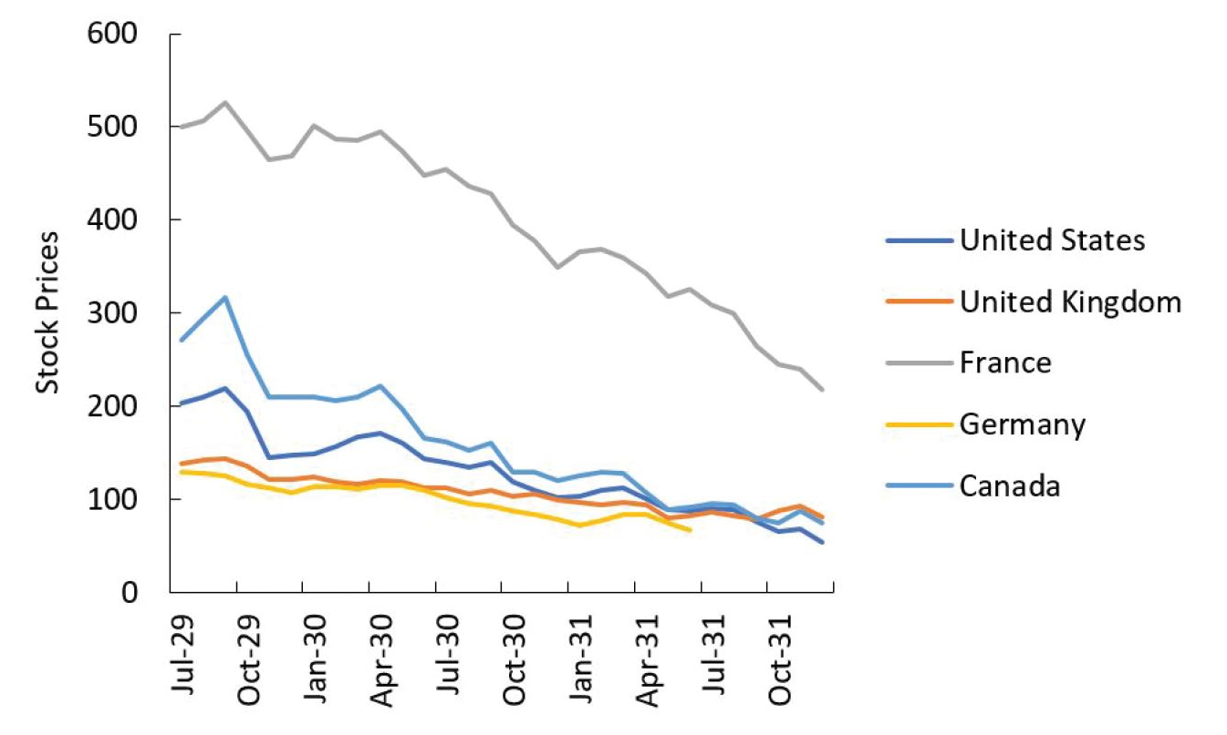
Figure 3 Stock Price Indexes in a Selected Number of Advanced Economies, 1929–1931
Source: Adapted from Kindleberger, 1986, Figure 6..

Slide 13
The Global Financial Crisis of 2007–2009 (1 of 8)
Causes of the 2007–2009 Financial Crisis:
Financial innovations emerge in the mortgage markets
Subprime mortgage
Mortgage-backed securities
Collateralized debt obligations (CDOs)
Housing price bubble forms
Increase in liquidity from cash flows surging to the United States
Development of subprime mortgage market fueled housing demand and housing prices

Slide 14
The Global Financial Crisis of 2007–2009 (2 of 8)
Causes (cont’d):
Agency problems arise
“Originate-to-distribute” model is subject to principal-(investor) agent (mortgage broker) problem
Borrowers had little incentive to disclose information about their ability to pay
Commercial and investment banks (as well as rating agencies) had weak incentives to assess the quality of securities
Information problems surface
Housing price bubble bursts

Slide 15
The Global Financial Crisis of 2007–2009 (3 of 8)
Effects of the 2007–2009 Financial Crisis
The growth in subprime mortgage market increased demand for houses and so fueled the boom in housing prices
After a sustained boom, housing prices in the U.S. and other countries (such as Ireland or Spain) began a long decline, starting in 2006.
The decline in housing prices contributed to a rise in defaults on mortgages and a deterioration in the balance sheet of financial institutions.
This development in turn caused a run on the shadow banking system.

Slide 16
The Global Financial Crisis of 2007–2009 (4 of 8)
Origins: U.S. financial markets
Crisis spreads globally
Sign of the globalization of financial markets
TED spread (3 months interest rate on Eurodollar minus 3 months Treasury bills interest rate) increased from 40 basis points to almost 240 in August 2007.

Slide 17
The Global Financial Crisis of 2007–2009 (5 of 8)
Deterioration of financial institutions’ balance sheets:
Write downs
Sell of assets and credit restriction
High-profile financial firms fail, in the U.S. and Europe
In the United States: Bear Stearns (March 2008), Fannie Mae and Freddie Mac (July 2008), Lehman Brothers, Merrill Lynch, AIG, Reserve Primary Fund (mutual fund) and Washington Mutual (September 2008)

Slide 18
The Global Financial Crisis of 2007–2009 (6 of 8)
High-profile financial firms fail, in the U.S. and Europe (contd.)
In the United Kingdom: Northern Rock (September 2008), Royal Bank of Scotland (October 2008)
Elsewhere: BPN (Portugal, November 2008), Anglo-Irish Bank (January 2009), the whole Icelandic banking sector (October 2008)

Slide 19
The Global Financial Crisis of 2007–2009 (7 of 8)
Bailouts
In the United States, Congress approved a $787 billion economic stimulus plan on February 13, 2009.
In the United Kingdom, the government announced a £500 billion bank rescue package in October, 2008.
Similarly, in countries such as Ireland, Spain, Belgium, and the Netherland, large scale rescue plans were announced to bail out ailing banks.

Slide 20
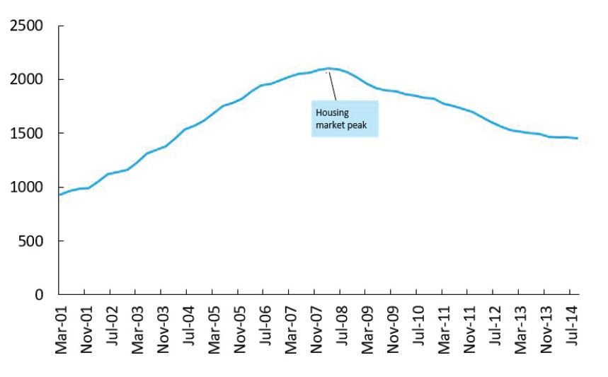
Figure 4 Residential Housing Prices in Spain
Source: Bank of Spain, Financial Accounts.

Slide 21
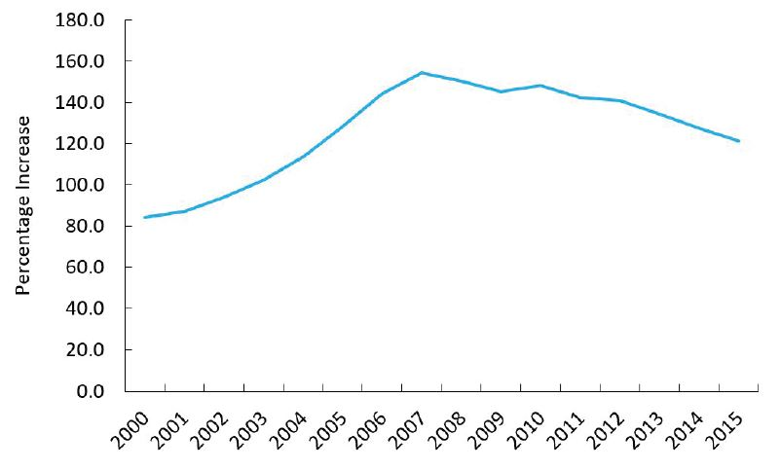
Figure 5 Total Spanish Household Debt as a Percentage of National Income
Source: Bank of Spain, Financial Accounts..

Slide 22
Inside the Fed: Was the Fed to Blame for the Housing Price Bubble? (1 of 2)
Some economists have argued that the low rate interest policies of the Federal Reserve in the 2003–2006 period caused the housing price bubble.
Taylor argues that the low federal funds rate led to low mortgage rates that stimulated housing demand and encouraged the issuance of subprime mortgages, both of which led to rising housing prices and a bubble.

Slide 23
Inside the Fed: Was the Fed to Blame for the Housing Price Bubble? (2 of 2)
Federal Reserve Chairman Ben Bernanke countered this argument saying the culprits were the proliferation of new mortgage products that lowered mortgage payments, a relaxation of lending standards that brought more buyers into the housing market, and capital inflows from emerging market countries.
The debate over whether monetary policy was to blame for the housing price bubble continues to this day.

Slide 24
The Global Financial Crisis of 2007–2009 (8 of 8)
Height of the 2007–2009 Financial Crisis
The stock market crash gathered pace in the fall of 2008, with the week beginning October 6, 2008, showing the worst weekly decline in U.S. history.
Surging interest rates faced by borrowers led to sharp declines in consumer spending and investment.
The unemployment rate shot up, going over the 10% level in late 2009 in the midst of the “Great Recession, the worst economic contraction in the United States since World War II.
Political consequences: electoral defeat of incumbent governments (Iceland, UK), unrest, increased polarization

Slide 25
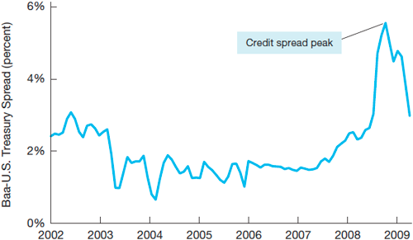
Figure 6 Credit Spreads and the 2007–2009 Financial Crisis
Source: Dow-Jones Industrial Average (DJIA). Global Financial Data: http://www.globalfinancialdata.com/index_tabs.php?action=detailedinfo&id=1165.

Slide 26
Government Intervention and the Recovery (1 of 2)
Short-term Responses and Recovery
Financial Bailouts: In order to save their financial sectors and to avoid contagion, financial support was provided by many governments to bail out banks, other financial institutions, and even the so-called “too-big-to-fail” firms that were severely affected by the financial crisis.
Fiscal Stimulus Spending: To boost their individual economies, most governments used fiscal stimulus packages that combined government expenditure and tax cuts.

Slide 27
Government Intervention and the Recovery (contd.) (2 of 2)
Short-term Responses and Recovery
Japan’s consecutive stimulus packages, totaling $568 billion, were among the highest during the crisis, but these proved largely ineffective
European nations showed moderate success.

Slide 28
Global: Latvia’s Different and Controversial Response (1 of 2)
Latvia’s independence from the USSR in 1991 and its fiscal policies helped it join the EU, 2004; and the Eurozone, 2014.
Latvia’s economic policies had a low budget deficit and a fixed exchange rate against the Euro.
In 2007, the country’s second-largest bank, Parex Bank, collapsed. Latvia needed €7.5 billion to recapitalize and meet external financing requirements.

Slide 29
Global: Latvia’s Different and Controversial Response (2 of 2)
Austerity program: citizens voluntarily endured the layoff of 25% of state workers, 40% salary cuts, and social expenditure reductions.
After a contraction of over 25%, the country’s GDP started to grow to its near pre-crisis levels.
Expansionary Contraction: Success in Latvia, but maybe inapplicable in other countries because of the political motivations involved.

Slide 30
Stabilizing the Global Financial System: Long-Term Responses
With the individual emergency national bailouts to rescue national economies and financial sectors, global leaders looked to building a more stable and robust global financial system. Steps taken by governments included
Implement sound macroeconomic policies
Enhance their financial infrastructure
Develop financial education and consumer protection rules
Enact macro- and microprudential regulations.

Slide 31
Long-Term Responses (contd.)
At the international level
proactive globally-binding supervision was designed
financial market discipline enforced
systemic risk managed
To avoid collective action problems and to ensure that policy actions are mutually consistent with national growth objectives, aggregate plans began to be drafted simultaneously. The first ever of these is the Mutual Assessment Process (MAP) launched in 2009 by the G20.

Slide 32
FYI The LIBOR Scandal (1 of 2)
LIBOR stands for “London Interbank Offered Rate”; it is an indicator of the cost of short-term money on the inter-bank market, calculated daily by Thomson-Reuters on the basis of reports by a sample of large banks.
It is the world's most important benchmark interest rates for hundreds of trillion dollars worth of financial products around the world.

Slide 33
FYI The LIBOR Scandal (2 of 2)
In June 2012, it was revealed that traders at four large banks had colluded since 2005 to manipulate the LIBOR, so as to make their banks appear to be in much healthier financial situation than they were in fact.
Given the financial significance of LIBOR, the scam was enormous.
After lengthy investigations, the four banks were fined $6 billion and criminal charges were pressed against those directly responsible.

Slide 34
Future Regulations and Policy Areas at the International Level (1 of 3)
The gravity of the 2007-08 crisis requires a more radical overhaul of the financial supervisory and regulatory system at the international level.
Such overhaul would also help decrease the risks of regulatory arbitrage, through which financial actors take advantage of loopholes in national regulatory systems.
Steps have recently been taken in this direction by regulators around the world, in four areas

Slide 35
Future Regulations and Policy Areas at the International Level (2 of 3)
Bilateral and multilateral supervisory coordination
Several initiatives of cross-country supervisory coordination have been adopted since the crisis, to help deal with liquidity shortages and global risk profiles
However, such initiatives are of limited effect, given their voluntary, non-binding nature
Collective supervisory cooperation
The G20 set up the Financial Stability Board in 2009
Aims to reveal regulatory gaps & harmonize financial regulation

Slide 36
Future Regulations and Policy Areas at the International Level (3 of 3)
Collectively coordinated macroeconomic plans
Needed to contribute to financial stability
Mutual Assessment Plan launched by the G20 in 2009
Self-discipline
Required to avoid the irresponsible and unethical behavior of bankers in the years leading to the 2007-08 crisis.
Various initiatives, such as the 2012 establishment of the Systemic Risk Council in the United States.

