Slide 1
The Economics of Money, Banking, and Financial Markets
Twelfth Edition, Global Edition
Chapter 14
Central Banks
Copyright © 2019 Pearson Education, Ltd.
Notes:
If this PowerPoint presentation contains mathematical equations, you may need to check that your computer has the following installed:
1) MathType Plugin
2) Math Player (free versions available)
3) NVDA Reader (free versions available)

Slide 2
Preview
This chapter considers the structure and activities of central banks focusing primarily on the European Central Bank and the Federal Reserve.
Among the most important players in financial markets throughout the world are central banks, the government authorities in charge of monetary policy.
Central banks’ actions affect interest rates, the amount of credit, and the money supply, all of which have direct impacts not only on financial markets but also on aggregate output and inflation

Slide 3
Learning Objectives (1 of 2)
Recognize the historical context of the development of the central banking system.
Describe the key features and functions of a central bank. Discuss the European Central Bank (ECB) and the Federal Reserve System.
Discuss the structure and degree of independence of the Bank of Canada, the Bank of Japan, and the People’s Bank of China.

Slide 4
Learning Objectives (2 of 2)
Discuss the structure and degree of independence of banks in emerging market economies.
Assess the degree of independence of central banks around the world.

Slide 5
Origins of the Central Banking System (1 of 2)
The Sveriges Riksbank or the Bank of Sweden, was established in 1668, with its main function being lending money to the government of Sweden.
Rising global trade increased the volume of international payments in the seventeenth century, hence the need to create more central banks throughout Europe.
The founding of the Bank of England (BoE) in 1694 marks the de facto origin of central banking.
Gradually, the central banking functions evolved in order to safeguard monetary stability, which required central banks to answer to their parliaments.

Slide 6
Origins of the Central Banking System (2 of 2)
To avoid the risk of power concentration, the structure of the Federal Reserve System, which was established in 1913, was designed to distribute power over 12 regional Federal Reserve banks and remained privately owned by its member banks.
Most emerging market economies established their central banks after WWII. The structure of these banks became similar to those of ECBs.
Over the last two centuries, the functions of central banks throughout the world expanded to regulating the value of the national currency, financing the government, and acting as a ‘lender of last resort’ to banks suffering from liquidity and/or credit crises.

Slide 7
Global: Who Should Own Central Banks
Arguments for public ownership:
Central banks act in the ultimate public interest.
Private ownership bias central banks toward self-serving profit-making interests, hence increasing risk-taking and balance sheet troubles.
The global financial crisis highlighted concerns that the profit-making target of private shareholders could hamper them from saving the financial sector during financial crises.
Arguments for private ownership:
guarantees central bank independence
restricts the distribution of dividends per share
private owners are required to recapitalize the central bank in the case of losses which lifts this burden off the fiscal budget.

Slide 8
Variations in the Functions and Structures of Central Banks
The roles of central banks have grown in importance as their activities evolve over time.
There are differences in the structure and policy tools that each central bank adopts depending on the level of sophistication of the banking and financial sectors.
Central banks have taken on increasing responsibilities which required more independence from fiscal authorities and political institutions.

Slide 9
The European Central Bank, the Euro System, and the European System of Central Banks (1 of 5)
The European Central Bank (ECB) came into existence on June 1, 1998, to handle the transitional issues of the nations that comprise the Eurozone.
The Eurozone is an economic and monetary union consisting of the member states of the European Union (EU) that have adopted the euro as their currency.
The creation of the Eurozone and of the new supranational institution, the ECB, was a milestone of European integration.
All of the member states of the European Union have to comply with a set of economic and legal conditions.

Slide 10
The European Central Bank, the Euro System, and the European System of Central Banks (2 of 5)
In January 1, 1999, only 11 EU member states had adopted the euro.
All of the Eurozone or euro area countries—i.e., the EU countries that have adopted the euro—retain their own National Central Banks (NCBs) and their own banking systems.
As of 2017, 19 countries out of the 28 member states of the European Union have joined the euro area.
The Eurosystem comprises the ECB and the NCBs of those EU member states that have adopted the euro.

Slide 11
The European Central Bank, the Euro System, and the European System of Central Banks (3 of 5)
Today, the EU is the world’s third largest economy after the United States and China in terms of GDP. As of 2017, the Eurozone had a population of 341 million citizens.
There are 19 countries in the EU: Austria, Belgium, Cyprus, Estonia, Finland, France, Germany, Greece, Ireland, Italy, Latvia, Lithuania, Luxembourg, Malta, the Netherlands, Portugal, Slovakia, Slovenia, and Spain.
In the U.K. referendum of June 23, 2016, 52% of British voters voted to exit the EU. Accordingly, the United Kingdom is scheduled to exit the EU in April 2019, a process that has come to be known as “Brexit.”

Slide 12
The European Central Bank, the Euro System, and the European System of Central Banks (4 of 5)
Since not all of the EU member states have adopted the euro, the European System of Central Banks (ESCB) was established alongside the Eurosystem to comprise the ECB and the NCBs of all EU member states whether or not they are members of the Eurozone.
The NCBs of the EU member states that have retained their national currencies are members of the ESCB which are allowed to conduct their own respective national monetary policies

Slide 13
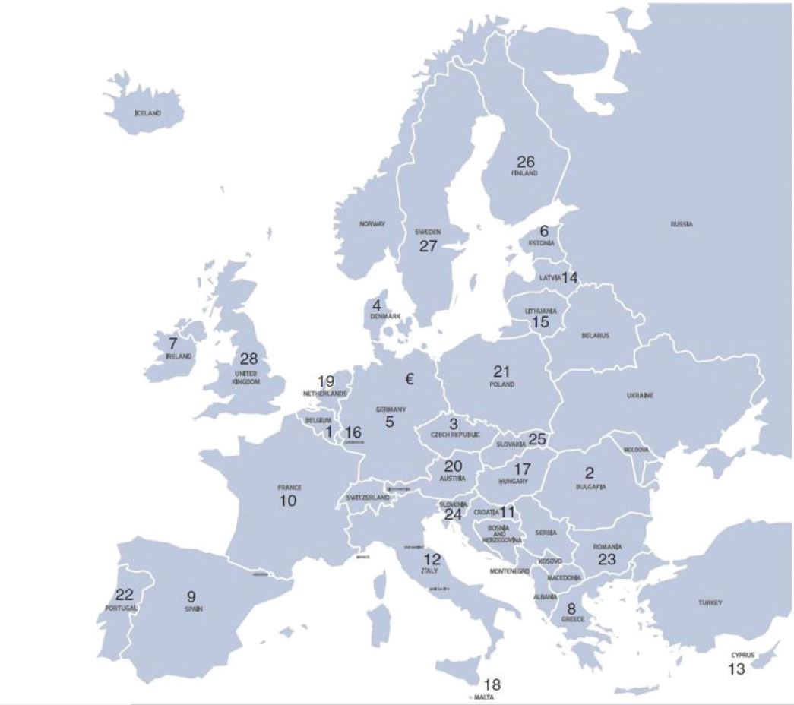
Figure 1 The Organization of the ESCB

Slide 14
The European Central Bank, the Euro System, and the European System of Central Banks (5 of 5)
The capital stock of the ECB is owned by the central banks of the current 28 EU member states
The balance sheet of the ECB—i.e., its assets and its liabilities—is held by the NCBs.
The shares of the NCBs in the total capital stock of the ECB are weighted according to the shares of the respective member states in the total population and GDP of the EU.
The ECB adjusts the shares every five years and whenever a new country joins the EU. The highest capital key percentages of the ECB’s capital are held by Deutsche Bundesbank and Banque de France.

Slide 15
Decision-Making Bodies of the ECB (1 of 5)
The three main decision-making bodies of the European Central Bank are
The Governing Council
The Executive Board
The General Council

Slide 16
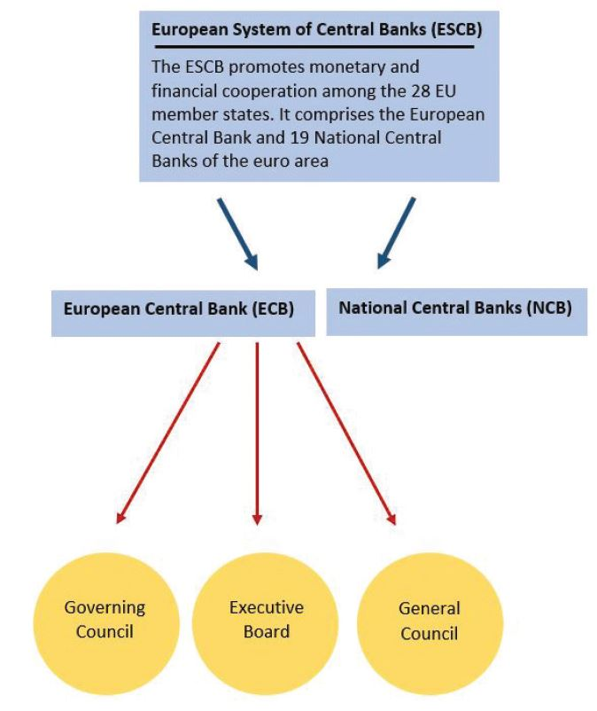
Figure 2 Structure and Responsibility for Policy Tools within the ESCB

Slide 17
Decision-Making Bodies of the ECB (2 of 5)
The Governing Council is the main decision-making body of the ECB responsible for formulating monetary policy in the euro area.
The main function of the Governing Council of the ECB is to conduct monetary policy with the primary objective to maintain price stability in the euro area.
The Governing Council is chaired by the ECB president and the council meets in Frankfurt on a fortnightly basis.
At the beginning of each month, the Governing Council decides on the monthly monetary policy decisions in accordance with the economic and monetary developments in the Eurozone.

Slide 18
Decision-Making Bodies of the ECB (3 of 5)
Euro area countries are divided into groups according to the size of their economies and the ranking of their financial sectors. The Governors from the five largest countries—Germany, France, Italy, Spain, and the Netherlands—share four voting rights. The remaining 14 countries share 11 voting rights.
The Executive Board of the ECB is responsible for the day-to-day operations and management of the ECB and the Eurosystem. The Executive Board comprises the following 6 members:
the president and the vice- president of the ECB,
four other members who take decisions in their personal capacity

Slide 19
Decision-Making Bodies of the ECB (4 of 5)
The third decision-making body is the General Council of the ECB, which comprises the president and the vice-president of the ECB in addition to the governors of the NCBs of the 28 EU member states.
Without having voting rights, a few officials are allowed to attend the meetings of the General Council such as members of the Executive Board of the ECB, the president of the EU Council, and one member of the European Commission.

Slide 20
Decision-Making Bodies of the ECB (5 of 5)
The main task of the General Council is to encourage cooperation between the National Central Banks of the member states of the EU.
The General Council also performs important advisory functions such as collecting statistical information for the ECB, preparing the ECB’s annual reports, and standardizing the accounting and reporting operations of the NCBs.
The Statute of the ESCB and the ECB state that the General Council is a transitional body which will be dissolved when all EU member states have introduced the single currency.

Slide 21
How Monetary Policy is Conducted within the ECB (1 of 8)
The three main objectives of the ECB are to:
maintain price stability in the economies of the EU
support the economic policies of the Eurozone nations
ensure an independent and open market economy
As price stability is important for attaining economic growth and job creation, the ECB endeavors to maintain its independence from governments.

Slide 22
How Monetary Policy is Conducted within the ECB (2 of 8)
The ECB was established in 1998 and headquartered in Frankfurt, Germany. In 1999, member states of the euro area, including Germany, ceded monetary and currency control to the ECB.
The Bundesbank’s size is influential in the crafting of Eurozone’s monetary policy at the ECB.
During the European sovereign debt crises, more than five bailouts were offered to the ailing European economies with the burden lying mostly on the Bundesbank.
Bundesbank was at odds with ECB, protesting that the monetary financing of budget deficits violates the ECB’s independence from government, political, and financial influence.

Slide 23
How Monetary Policy is Conducted within the ECB (3 of 8)
To achieve its primary objective of price stability, the ECB aims to maintain a medium-term inflation rate closely below 2%. The Governing Council of the ECB sets the following three key policy interest rates:
Deposit facility rate, which is the rate on tenders to banks. It is the most important policy rate because it provides the bulk of liquidity to the banking system and determines how far down the ECB’s quantitative easing program can push sovereign bond yields.
Refinancing rate, which is the rate on overnight deposits with the Eurosystem
Marginal lending facility rate, which is the rate on overnight credit to banks from the Eurosystem

Slide 24
How Monetary Policy is Conducted within the ECB (4 of 8)
The ECB’s operational framework consists of the following set of conventional monetary policy instruments:
open market operations
standing facilities to provide and absorb overnight liquidity
minimum or required reserve requirements for credit institutions.
Since September 2008 , the ECB has introduced a number of unconventional or non-standard monetary policy measures to complement the regular operations of the Euro system when standard monetary policy has become ineffective at combating a falling money supply and economic recessions.

Slide 25
How Monetary Policy is Conducted within the ECB (5 of 8)
The unconventional monetary policy measures include:
Emergency liquidity assistance (ELA)—that provides liquidity and loans exceptionally to solvent banking and financial institutions that are facing temporary liquidity problems.
Quantitative easing, where central banks buy sovereign bonds and/or other financial assets from commercial banks and financial institutions to increase money supply and stimulate the economy. Examples of these are the asset purchase programmes (APP) and the Securities Market Programme (SMP).The APP includes purchases of public sector securities, private sector bonds, and asset-backed securities while the SMP strictly limits purchases of government bonds by the Eurosystem to secondary markets.

Slide 26
How Monetary Policy is Conducted within the ECB (6 of 8)
The non-traditional monetary policy tools were temporary and aimed at providing liquidity to financial markets and reducing pressures on interest rates.
Since 2014, the ECB has introduced a negative interest rate policy (NIRP) on bank deposits in order to reduce the slowdown in the economy.
The ECB itself does not conduct monetary policies, but assigns these tasks to the central banks. For example, in the case of the quantitative easing program, the 19 National Central Banks are tasked with buying bonds in their respective sovereign bond markets.

Slide 27
How Monetary Policy is Conducted within the ECB (7 of 8)
Are Non-Euro Central Banks Constrained by Membership of the EU?
The 19 euro area nations share a common currency, joint monetary policy rules, and flexible labor mobility. However, the Eurozone lacks intra-country fiscal budgetary transfers that are an essential shock absorbing mechanism.
Strong sentiments of national pride, the imperfect labor market conditions and the infeasibility of fiscal integration have impelled many EU nations to refrain from adopting the euro.
The most important disadvantage that non-Eurozone EU nations wanted to avoid was the loss of their fiscal and/or monetary autonomy. The non-Eurozone EU nations wanted to retain the ability to freely conduct and implement their home-grown fiscal and monetary policies.

Slide 28
How Monetary Policy is Conducted within the ECB (8 of 8)
Are Non-Euro Central Banks Constrained by Membership of the EU? (contd.)
EU rulings allow domestic central banks to freely implement conventional monetary policies.
However, the stimulus programs and unconventional monetary policies undertaken by the central banks of non-Eurozone EU states during both the global financial crisis and the European Sovereign Crisis had to be conducted in coordination with the European Central Bank. These are only special cases at the unusual times of financial crises.
Under normal conditions, non-Euro zone EU central banks are not constrained by their countries’ membership of the EU.

Slide 29
The Federal Reserve System (1 of 4)
The Federal Reserve System, also known as the Federal Reserve bank or the Fed for short, is one of the largest and most influential central banks in the world.
The Fed is an independent entity that is privately owned by its member banks.
The Fed is subject to oversight from Congress that periodically reviews its activities.
The Fed supervises and regulates the nation’s financial institutions and simultaneously serves as their banker.

Slide 30
The Federal Reserve System (2 of 4)
The Federal Reserve Bank of New York plays a special role in the Federal Reserve System for several reasons.
First, its district contains many of the largest commercial banks in the United States, the safety and soundness of which are paramount to the health of the U.S. financial system.
The second reason for the New York Fed’s special role is its active involvement in the bond and foreign exchange markets.

Slide 31
The Federal Reserve System (3 of 4)
The Federal Reserve System consists of the following:
The Federal Reserve Board of Governors (FRB) which mainly assumes regulatory and supervisory responsibilities over member banks.
The Federal Open Market Committee (FOMC): comprises 12 members— seven members of the Federal Reserve Board of Governors, president of the Federal Reserve bank of New York, and 4 of the regional Federal Reserve bank presidents.
Voting member in 2020: https://www.federalreserve.gov/monetarypolicy/fomc.htm
The FOMC convenes eight times a year to decide on the interest rates and monetary policy.

Slide 32
The Federal Reserve System (4 of 4)
The 12 Federal Reserve banks that are located in major cities throughout the nation
Private U.S. member banks
The Federal Advisory Council

Slide 33
Comparing the ECB and the Fed (1 of 3)
Both the ECB and the Fed are entities that bind a number of regional central banks together, 19 National Central Banks for the ECB and 12 regional Federal Reserve banks for the Fed.
Both are independent institutions with a decentralized structure
The ECB supports political independence and makes monetary policy decisions independent of political authorities.
The Fed is highly independent of the government and reports to the Congress.

Slide 34
Comparing the ECB and the Fed (2 of 3)
Important differences between the structure of the Eurosystem and that of the Fed:
The primary objective of the ECB is to achieve price stability. On the other hand, the Fed’s dual mandate and monetary policy objective is to deliver price stability and consequently to support the macroeconomic objectives including those for growth and employment. The Fed often ignores the temporary effects of price changes since it considers unemployment to be a much bigger priority.
The budgets of the Federal Reserve banks are controlled by the Board of Governors, whereas the National Central Banks control their own budgets and the budget of the ECB in Frankfurt.

Slide 35
Comparing the ECB and the Fed (3 of 3)
The monetary operations of the Euro system are not centralized but conducted by the National Central Banks while monetary operations are centralized in the Federal Reserve System.
The ECB is not involved in supervision and regulation of financial institutions as these tasks are left to the individual countries in the European Monetary Union, while the Federal Reserve is involved in these areas.
In financing fiscal budget deficits, the Fed buys government bonds outright, while the ECB accepts them as collateral for new loans to the banking system.

Slide 36
The Bank of England (1 of 4)
The British central bank or the Bank of England (BoE), known as the ‘Old Lady’ of Threadneedle Street, was founded in 1694.
As the second-oldest central bank in the world, the BoE model has been the basis of most other central banks of the world.
The BoE is accountable to the U.K. Parliament. As the United Kingdom is not a member of the euro area, the BoE makes its monetary policy decisions independently from the ECB.

Slide 37
The Bank of England (2 of 4)
The Bank’s Monetary Policy Committee (MPC) is responsible for conducting monetary policy.
It has 9 members, of which 5 are BoE staff and 4 members of the Committee are independent experts chosen from outside the bank.
The MPC meets over three days, eight times a year to:
deliver price stability
support the government’s economic objectives including those for growth and employment.

Slide 38
The Bank of England (3 of 4)
Interest rate is the main policy tool that the BoE uses for controlling growth.
However, as interest rates were cut close to zero since the global financial crisis, many central banks including the BoE have used quantitative easing as an unconventional form of monetary policy.
Quantitative easing aims to directly increase private sec- tor spending in the economy and return inflation to target.

Slide 39
The Bank of England (4 of 4)
The government’s inflation target is announced each year by the Chancellor of the Exchequer in the annual Budget statement.
The minutes of the MPC meetings are published simultaneously with the interest rate decision.
This gives the BoE less autonomy in comparison to the Fed.

Slide 40
Global: Brexit and the BOE (1 of 3)
Brexit refers to the United Kingdom’s intended withdrawal from the EU in the wake of a 51.9% referendum vote on June 23, 2016.
United Kingdom’s financial services sector provides 75% of foreign exchange trading and supports half of all lending for the EU with British investment banks providing 75% of all hedging products.
Brexit will have economic and financial repercussions on the United Kingdom.
The extent of the repercussions of Brexit depends largely on the kind of future relationship that the United Kingdom will develop with the EU.

Slide 41
Global: Brexit and the BOE (2 of 3)
A hard Brexit arrangement, or no exit agreement with the EU, would likely see the United Kingdom give up full access to the single market. This would give Britain full control over its borders enabling it to increase customs.
A hard Brexit means that financial firms would not be able to keep their “passporting” rights to sell services and operate branches freely in the United Kingdom without the authorization of the BoE.
This would increase operational costs and supervision costs as well as magnify the risk of unexpected breaks in the provision of financial services such as loans to firms and consumers.

Slide 42
Global: Brexit and the BOE (3 of 3)
On the other hand, a soft Brexit arrangement would leave the United Kingdom’s relationship with the EU as close as possible to the existing arrangements.
Hence, before leaving the EU by March 2019, an adequate implementation period is desirable in order to give U.K. and EU firms more time to make the necessary changes.

Slide 43
Structure of Central Banks in Larger Economies
We next examine the structure and degree of independence of three other important and large central banks:
Bank of Canada,
Bank of Japan
People’s Bank of China

Slide 44
The Bank of Canada (1 of 4)
The Bank of Canada (BoC) started in 1935 as a privately owned financial institution but was turned into public ownership since 1938.
There are five Regional Bank of Canada offices in Vancouver, Calgary, Toronto, Montreal, and Halifax.
The BoC practices regulatory and supervisory responsibilities over Canadian banks and reports its monetary policy decisions to the House of Commons.
While the Bank of Canada controls monetary policy, the Bank Act amendment in 1967 gives the ultimate responsibility for monetary policy to the government. When disagreement arises, the minister of finance can issue a directive that the BoC must follow.

Slide 45
The Bank of Canada (2 of 4)
The main mandate of the BoC is to preserve the value of money by keeping inflation low, stable and predictable.
BoC adopts a dual key monetary policy framework comprising inflation-control target and flexible exchange rate.
The BoC decisions are announced eight times a year.
The Governing Council of the BoC is the main monetary policy-making body.
Other major participants that assist the Governing Council in the monetary policy decision-making are the Monetary Policy Review Committee (MPRC) and the four economics departments at the BoC.

Slide 46
The Bank of Canada (3 of 4)
The monetary policy decision-making is a complicated process that goes through the following five key stages.
The BoC’s staff present their initial projection of monetary policy to the Governing Council about two and a half weeks before the interest rate decision. This projection uses economic modeling and simulation to produce a base-case or most likely scenario.
A second major briefing occurs one week before the decision. It includes an update on economic developments, risks, business outlook, inflation, credit conditions, financial market conditions, and monetary policy expectations in Canada, the United States, and globally.

Slide 47
The Bank of Canada (4 of 4)
The monetary policy decision-making is a complicated process that goes through the following five key stage (contd.).
Final policy recommendations are presented two days after the major briefing and serve as the starting point for an extensive discussion by the entire MPRC
Deliberations take place Thursdays through Mondays and decisions are taken on Tuesdays
The BoC announces its decision on Wednesday and publishes a press release that explains the reasons behind its decision

Slide 48
The Bank of Japan (1 of 3)
The Bank of Japan (BoJ), Nippon Ginko or Nichigin, was founded in 1882 during the Meiji Restoration.
It is headquartered in Tokyo and has 32 branches, the largest being in Osaka. The Bank of Japan was restructured after WWII in 1949.
Up until the early nineties, the main monetary policy tool used by the BoJ was the imposition of bank credit growth quotas on the commercial banks.
The Bank of Japan was not formally independent of the government, with the ultimate power residing with the Ministry of Finance until the Bank of Japan Act of 1997 changed this situation.

Slide 49
The Bank of Japan (2 of 3)
The two main mandates of the BoJ are price stability and financial sector stability in order to achieve stable and sustainable macroeconomic growth.
The Bank of Japan Act granted greater instrument and goal independence to the BoJ.
Monetary policy is determined by the Policy Board of the BoJ which makes monetary policy decisions eight times a year. It is regarded as the outcome of a bargaining process between the government and the Bank of Japan.
The Ministry of Finance has lost its authority to oversee many operations of the BoJ, particularly the right to dismiss senior officials but continues to have control over the part of the bank’s budget that is unrelated to monetary policy.

Slide 50
The Bank of Japan (3 of 3)
The BoJ lacks the autonomy to influence the yen exchange rate.
The BoJ acts on behalf of the Ministry of Finance which instructs the central bank to conduct foreign exchange intervention by buying or selling yen against foreign currencies using government funds as well as the foreign assets of the central bank.
The 1997 Bank of Japan Act has reduced the scope of action and the independence of the BoJ in comparison to its European counterparts.

Slide 51
The People’s Bank of China (1 of 3)
The Chinese central bank is known as the People’s Bank of China (PBoC). The PBoC was founded in 1949 as a result of the merger of three of the largest commercial banks.
As of 2017, the People’s Bank of China has the largest financial asset holdings and foreign currency reserves held by any central bank in the world.
The main mandate of the People’s Bank of China is to maintain the stability of the value of the currency, reduce overall risk and promote stability of the financial system to enhance economic growth.

Slide 52
The People’s Bank of China (2 of 3)
The PBoC reports to the Standing Committee of the National People’s Congress.
The Monetary Policy Committee (MPC) consists of 13 members comprising of the PBoC’s governor, two deputy governors, and key representatives of various government institutions.
The MPC convenes on a quarterly basis to make monetary policy decisions employing interest rates and reserve requirements as the main policy tools.
The PBoC imposes high reserve requirement which sometimes reaches 18-20%.

Slide 53
The People’s Bank of China (3 of 3)
In earlier years, the PBoC held a three-percentage point gap between deposit and lending rates which provided easy profits for banks when deposits are turned into loans.
The PBoC has been slowly liberalizing interest rates since the turn of the century.
While it still continues to publish benchmark deposit and lending rates, the PBoC has now set banks free and allowed them to pay depositors whatever interest they like.
The PBoC remains one of the least independent central banks.

Slide 54
Structure and Independence of Central Banks of Emerging Market Economies (1 of 3)
Emerging markets economies (EMEs) are economies of Asia, Latin America, and Eastern Europe that are growing rapidly and experiencing booming industrialization and increased exports.
Central banks of EMEs assume a more complex role in comparison to their counterparts in industrial nations.
Apart from central banking functions, banks of EMEs build and reform the financial infrastructure, develop the financial markets, and help with macroeconomic development. They also manage foreign exchange reserves and implement policies that promote growth and exports.

Slide 55
Structure and Independence of Central Banks of Emerging Market Economies (2 of 3)
The Reserve Bank of India (RBI), South African Reserve Bank, Banco do Brasil, and Bank Negara Malaysia are among the most successful central banks in EMEs.
These central banks have successfully reformed their banking sectors and supervised them to shelter the EMEs from contagion during the global financial crisis.
The central banks of EMEs pursue “financial inclusion policies” which involve enhancing credit flow to productive export-oriented industries and employment intensive sectors. They also subsidize banks and increase access to affordable financial services, promote financial education and literacy, and support small local rural banks.

Slide 56
Structure and Independence of Central Banks of Emerging Market Economies (3 of 3)
To achieve these development roles, the central banks often coordinate monetary policy decisions with fiscal agents.
The central banks in EMEs have less independence because many decisions regarding foreign exchange, developing financial institutions and markets, and extending loans to priority regions and sectors are made jointly with the government.

Slide 57
Should Central Banks be Independent? (1 of 6)
During the last four decades, both theory and empirical evidence have suggested that monetary policy is more effective when a central bank is more independent. There are two key dimensions of central bank independence.
Goal independence which encompasses the institutional characteristics that insulate the central bank from political influence in defining its monetary policy objectives.
Instrument independence which refers to the ability of the central bank to freely implement policy instruments in its pursuit to meet the monetary goals.

Slide 58
Should Central Banks be Independent? (2 of 6)
The case for independence:
Potential inflationary biases that are likely to exert themselves as a result of political pressure to boost output in the short run. This tends to lead to a political business cycle, in which these expansionary monetary policies are reversed after the election to limit inflation, thus leading to booms and busts in the economy.
The public generally distrusts politicians in regard to making politically motivated decision and their lack of expertise in conducting monetary policy.

Slide 59
Should Central Banks be Independent? (3 of 6)
The case for independence:
Politicians often opt for more central bank independence when there is disagreement between policymakers regarding unpopular macroeconomic decisions. The politicians grant more independence to the central bank in order to avoid public criticism. This was the case in many EMEs that were forced to float or liberalize their domestic currencies in order to integrate with global financial markets.

Slide 60
Should Central Banks be Independent? (4 of 6)
The case against independence:
Macroeconomic stability can be best achieved if monetary policy is properly coordinated with fiscal policy. As the government is responsible for the country’s macroeconomic performance, it must have some control over monetary policy.
Central banks are not immune from political pressures. The theory of bureaucratic behavior suggests that the objective of a bureaucracy is to maximize its own welfare just as consumer behavior aims to maximize personal welfare. Thus, the central bank can pursue a course of narrow self-interest to increase its power and prestige at the expense of public interest.

Slide 61
Should Central Banks be Independent? (5 of 6)
The trend toward greater independence:
The high correlation between macroeconomic and price stability and central bank independence has led to the trend to enhance central bank independence globally.
To ensure that central banks do not deviate from their socioeconomic goals, most central banks are made accountable to their parliaments and required to become more transparent about their operations.
While the Federal Reserve has historically been more independent than most other central banks, the structure and the level of political independence of the European Central Bank make it even more independent.

Slide 62
Should Central Banks be Independent? (6 of 6)
The trend toward greater independence:
The central banks that have been traditionally subject to the intervention of the ministry of finance, such as the Bank of England and the Bank of Japan, have also been granted more independence in the 1990s.
The Bank of England is among the most independent central banks with regard to the central banks’ functions of bank regulation and supervision, The Bank of England has formed the Financial Policy Committee and invited a non-voting member from the U.K. Treasury. Conversely, the U.S. Financial Stability Oversight Council comprises all of the principal regulators as members and the Secretary of the Treasury as chairman.

