Slide 1
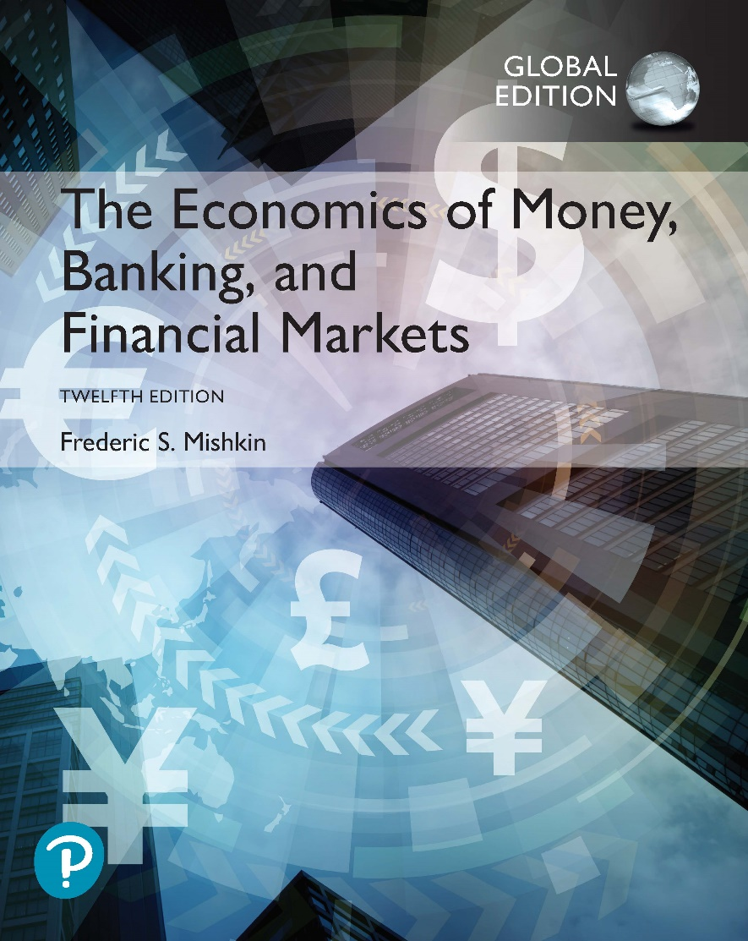
The Economics of Money, Banking, and Financial Markets
Twelfth Edition, Global Edition
Chapter 19
The International Financial System
Copyright © 2019 Pearson Education, Ltd.
Notes:
If this PowerPoint presentation contains mathematical equations, you may need to check that your computer has the following installed:
1) MathType Plugin
2) Math Player (free versions available)
3) NVDA Reader (free versions available)

Slide 2
Preview
This chapter examines how international financial transactions and the structure of the international financial system affect monetary policy.

Slide 3
Learning Objectives (1 of 2)
Use graphs and T-accounts to illustrate the distinctions between the effects of sterilized and unsterilized interventions on foreign exchange markets.
Interpret the relationships among the current account, the capital account, and official reserve transactions balance.
Identify the mechanisms for maintaining a fixed exchange rate and assess the challenges faced by fixed exchange rate regimes.
Summarize the advantages and disadvantages of capital controls.

Slide 4
Learning Objectives (2 of 2)
Assess the role of the IMF as an international lender of last resort.
Identify the ways in which international monetary policy and exchange rate arrangements can affect domestic monetary policy operations.
Summarize the advantages and disadvantages of exchange-rate targeting.

Slide 5
Intervention in the Foreign Exchange Market (1 of 4)
Foreign exchange intervention and the money supply
Federal Reserve System | Blank | Blank | Blank
Assets | Blank | Liabilities | Blank
Foreign Assets | −$1B | Currency in Circulation | −$1B
(International Reserves) | Blank | Blank | Blank
Federal Reserve System | Blank | Blank | Blank
Assets | Blank | Liabilities | Blank
Foreign Assets | −$1B | Deposits with the Fed | −$1B
(International Reserves) | Blank | (reserves) | Blank

Slide 6
Intervention in the Foreign Exchange Market (2 of 4)
A central bank’s purchase of domestic currency and corresponding sale of foreign assets in the foreign exchange market lead to an equal decline in its international reserves and the monetary base.
A central bank’s sale of domestic currency to purchase foreign assets in the foreign exchange market results in an equal rise in its international reserves and the monetary base.

Slide 7
Intervention in the Foreign Exchange Market (3 of 4)
Unsterilized foreign exchange intervention:
An unsterilized intervention in which domestic currency is sold to purchase foreign assets leads to a gain in international reserves, an increase in the money supply, and a depreciation of the domestic currency.

Slide 8
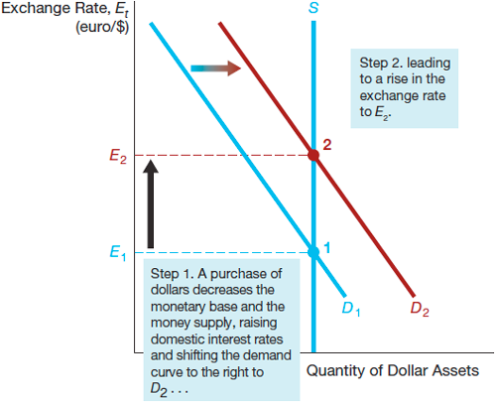
Figure 1 Effect of an Unsterilized Purchase of Dollars and Sale of Foreign Assets

Slide 9
Intervention in the Foreign Exchange Market (4 of 4)
Sterilized foreign exchange intervention
Federal Reserve System | Blank | Blank | Blank
Assets | Blank | Liabilities | Blank
Foreign Assets (International Reserves) | −$1B | Monetary Base (reserves) | 0
Government Bonds | +$1B | Blank | Blank
To counter the effect of the foreign exchange intervention, conduct an offsetting open market operation.
There is no effect on the monetary base and no effect on the exchange rate.

Slide 10
Balance of Payments
A bookkeeping system used to record all receipts and payments that have a direct on the movement of funds between a nation and foreign countries.
Current Account
International transactions that involve currently produced goods and services
Trade Balance
Capital Account
Net receipts from capital transactions
Sum of these two is the official reserve transactions balance

Slide 11
Global: Should We Worry About the Large U.S. Current Account Deficit?
Persistent trade (balance-of-payment) deficits are a concern for several reasons.
First, it indicates that, at current exchange rates, foreign demand for U.S. exports is far less than the U.S. demand for foreign goods.
Second, a current account deficit means that foreigners’ claim on U.S. assets is growing.

Slide 12
Exchange Rate Regimes in the International Financial System (1 of 3)
Fixed exchange rate regime
Value of a currency is pegged relative to the value of one other currency (anchor currency)
Floating exchange rate regime
Value of a currency is allowed to fluctuate against all other currencies
Managed float regime (dirty float)
Attempt to influence exchange rates by buying and selling currencies

Slide 13
Exchange Rate Regimes in the International Financial System (2 of 3)
Gold standard
Before World War I
Fixed exchange rates
No control over monetary policy
Influenced heavily by production of gold and gold discoveries
Bretton Woods System
After World War II and before 1973
Fixed exchange rates using U.S. dollar as reserve currency
International Monetary Fund (IMF)

Slide 14
Exchange Rate Regimes in the International Financial System (3 of 3)
Bretton Woods System (cont’d)
World Bank
General Agreement on Tariffs and Trade (GATT)
World Trade Organization
European Monetary System
A fixed exchange rate system instituted among EU members
Exchange rate mechanism

Slide 15
How the Bretton Woods System Worked
Exchange rates adjusted only when experiencing a “fundamental disequilibrium” (large persistent deficits in balance of payments)
Loans from IMF to cover loss in international reserves
IMF encouraged contractionary monetary policies
Devaluation only if IMF loans were not sufficient
No tools for surplus countries
U.S. could not devalue currency

Slide 16
How a Fixed Exchange Rate Regime Works
When the domestic currency is overvalued, the central bank must:
Purchase domestic currency to keep the exchange rate fixed (it loses international reserves), or
Conduct a devaluation
When the domestic currency is undervalued, the central bank must:
Sell domestic currency to keep the exchange rate fixed (it gains international reserves), or
Conduct a revaluation

Slide 17
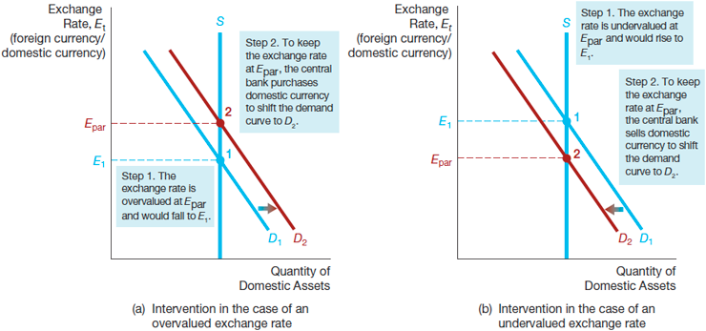
Figure 2 Intervention in the Foreign Exchange Market Under a Fixed Exchange Rate Regime

Slide 18
European Monetary System (EMS)
Eight members of EEC fixed exchange rates with one another and floated against the U.S. dollar.
ECU value was tied to a basket of specified amounts of European currencies.
Fluctuated within limits.
Led to foreign exchange crises involving speculative attacks. To illustrate consider the market for British pounds in 1992.

Slide 19
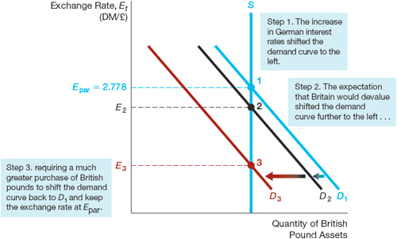
Figure 3 Foreign Exchange Market for British Pounds in 1992

Slide 20
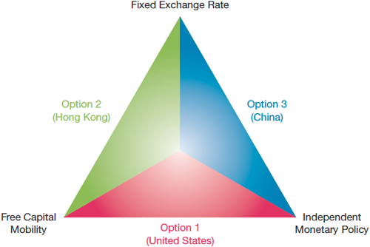
Figure 4 The Policy Trilemma (Impossible Trinity)

Slide 21
Application: How Did China Accumulate $4 Trillion of International Reserves?
By 2014, China had accumulated $4 trillion in international reserves.
China’s rapid growth of productivity, accompanied by an inflation rate lower than that of the U.S., caused the long-run value of the yuan to increase.
The Chinese central bank engaged in massive purchases of U.S. dollar assets to maintain the fixed relationship between the Chinese yuan and the U.S. dollar.

Slide 22
Monetary Unions
A variant of a fixed exchange rate regime is a monetary (or currency) union (e.g., EMU), in which a group of countries decides to adopt a common currency, thereby fixing the countries’ exchange rates in relation to each other.
Pros: Trade across broader is easier
Cons: Individual countries no longer have their own independent monetary policies

Slide 23
Managed Float
Hybrid of fixed and flexible
Small daily changes in response to market
Interventions to prevent large fluctuations
Rates fluctuate in response to market forces but are not determined solely by them
Appreciation hurts exporters and employment
Depreciation hurts imports and stimulates inflation

Slide 24
Global: Will the Euro Survive?
The global financial crisis of 2007–2009 led to economic contraction throughout Europe, with the countries in the southern part of the Eurozone hit especially hard.
Adopting easier monetary policy in southern countries to stimulate economic activities is not a possible option.
This “straightjacket” effect of the euro has weakened support for the euro in the southern countries, leading to increased talk of abandoning the euro.

Slide 25
Capital Controls (1 of 2)
Restrictions on capital mobility can help avoid financial instability
Controls on capital outflows:
Promote financial instability by forcing a devaluation
Seldom effective and may increase capital flight
Lead to corruption
Lose opportunity to improve the economy
Controls on capital inflows:
Lead to a lending boom and excessive risk-taking by financial intermediaries

Slide 26
Capital Controls (2 of 2)
Controls on inflows (cont’d):
Controls may block funds for production uses
Produce substantial distortion and misallocation
Leads to corruption
Strong case for improving bank regulation and supervision

Slide 27
The Role of the IMF
It was originally set up under the Bretton Woods system to help countries deal with balance-of-payments problems and stand by the fixed exchange rates by lending to deficit countries
May be able to prevent contagion.
It acts as an international lender of last resort, but the safety net may lead to excessive risk-taking (moral hazard problem).

Slide 28
How Should the IMF Operate?
May not be tough enough (not put enough pressure on the governments).
Austerity programs focus on tight macroeconomic policies rather than financial reform.
Too slow, which worsens crisis and increases costs.
Countries were restricting borrowing from the IMF until the recent subprime financial crisis.

Slide 29
International Considerations and Monetary Policy (1 of 2)
Monetary policy can be affected by international matters in several ways
Balance of payment considerations:
Current account deficits in the United States suggest that American businesses may be losing ability to compete because the dollar is too strong.
U.S. deficits mean surpluses in other countries ⇒ large increases in their international reserve holdings ⇒ world inflation.

Slide 30
International Considerations and Monetary Policy (2 of 2)
Exchange rate considerations:
A contractionary monetary policy will raise the domestic interest rate and strengthen the currency.
An expansionary monetary policy will lower interest rates and weaken currency.

Slide 31
To Peg or Not to Peg: Exchange-Rate Targeting As an Alternative Monetary Policy Strategy
Advantages of exchange-rate targeting:
Contributes to keeping inflation under control
Automatic rule for conduct of monetary policy
Simplicity and clarity
Disadvantages of exchange-rate targeting:
Cannot respond to domestic shocks and shocks to anchor country are transmitted
Open to speculative attacks on currency
Weakens the accountability of policy makers as the exchange rate loses value as signal

Slide 32
When Is Exchange-Rate Targeting Desirable for Industrialized Countries?
Exchange-rate targeting for industrialized countries is desirable if
Domestic monetary and political institutions are not conducive to good policy making
Other important benefits such as integration arise from this strategy

Slide 33
When Is Exchange-Rate Targeting Desirable for Emerging Market Countries?
Exchange-rate targeting for emerging market countries is desirable if
Political and monetary institutions are weak (strategy becomes the stabilization policy of last resort).

Slide 34
Currency Boards
An arrangement in which domestic currency is backed 100% by a foreign currency.
Stronger commitment to fixed exchange rate by central bank.
Solution to lack of transparency and commitment to target.
Note issuing authority establishes a fixed exchange rate and stands ready to exchange currency at this rate.
Money supply can expand only when foreign currency is exchanged for domestic currency.
Loss of independent monetary policy and increased exposure to shock from anchor country.
Loss of ability to create money and act as lender of last resort.

Slide 35
Global: Argentina’s Currency Board
The currency board experiment in Argentina was initially a stunning success, with inflation falling from 800% in 1990 to less than 5% in 1994.
Due to the long-term weakness in Argentine exports and bad timing, the currency board ultimately ended in widespread violence and bloodshed in January 2002.

Slide 36
Dollarization
Another solution to lack of transparency and commitment
Adoption of another country’s money
Even stronger commitment mechanism
Completely avoids possibility of speculative attack on domestic currency
Lost of independent monetary policy and increased exposure to shocks from anchor country
Inability to create money and act as lender of last resort
Loss of seignorage

