Slide 1
The Economics of Money, Banking, and Financial Markets
Twelfth Edition, Global Edition
Chapter 22
The Monetary Policy and Aggregate Demand Curves
Copyright © 2019 Pearson Education, Ltd.
Notes:
If this PowerPoint presentation contains mathematical equations, you may need to check that your computer has the following installed:
1) MathType Plugin
2) Math Player (free versions available)
3) NVDA Reader (free versions available)

Slide 2
Preview
This chapter develops an explanation for why monetary policy makers put upward pressure on interest rates when inflation increases.
This relationship is then used to develop the monetary policy curve.
The monetary policy curve is then used in conjunction with the IS schedule to derive an aggregate demand curve, which shall be used in the discussions that follow.

Slide 3
Learning Objectives
Recognize the impact of changes in the nominal federal funds rate on short-term real interest rates.
Define and illustrate the monetary policy (MP) curve and explain shifts in the MP curve.
Explain why the aggregate demand (AD) curve slopes downward and explain shifts in the AD curve.

Slide 4
The Federal Reserve and Monetary Policy
The Fed of the United States conducts monetary policy by setting the federal funds rate—the interest rate at which banks lend to each other.
When the Federal Reserve lowers the federal funds rate, real interest rates fall.
When the Federal Reserve raises the federal funds rate, real interest rates rise.

Slide 5
The Monetary Policy Curve
The monetary policy (MP) curve shows how monetary policy, measured by the real interest rate, reacts to the inflation rate, π:
The MP curve is upward sloping. Real interest rates rise when the inflation rate rises.

Slide 6
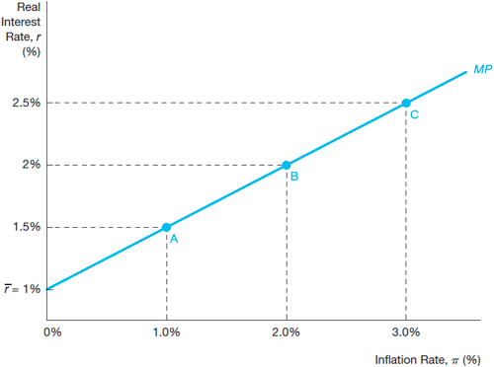
Figure 1 The Monetary Policy Curve

Slide 7
The Taylor Principle: Why the Monetary Policy Curve Has an Upward Slope
The key reason for an upward sloping MP curve is that central banks seek to keep inflation stable.
Taylor principle: To stabilize inflation, central banks π must raise nominal interest rates by more than any rise in expected inflation, so that r rises when rises.
Schematically, if a central bank allows r to fall when π rises, then (Y^{ad} = AD):

Slide 8
Shifts in the MP Curve
Two types of monetary policy actions that affect interest rates:
Automatic (Taylor principle) changes as reflected by movements along the MP curve (2004–2006)
Autonomous changes that shift the MP curve
Autonomous tightening of monetary policy that shifts the MP curve upward
Autonomous easing of monetary policy that shifts the MP curve downward (in order to stimulate the economy as what the Fed was doing at the onset of the global financial crisis)

Slide 9
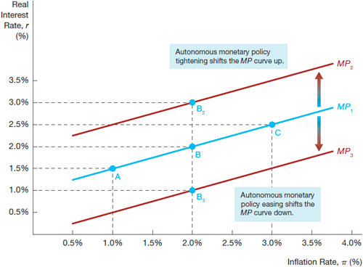
Figure 2 Shifts in the Monetary Policy Curve

Slide 10
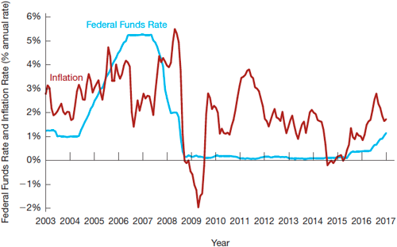
Figure 3 The Federal Funds Rate and Inflation Rate, 2003–2017

Slide 11
The Aggregate Demand Curve
The aggregate demand curve represents the relationship between the inflation rate and aggregate demand when the goods market is in equilibrium.
The aggregate demand curve is central to aggregate demand and supply analysis, which allows us to explain short-run fluctuations in both aggregate output and inflation.

Slide 12
Deriving the Aggregate Demand Curve Graphically
The AD curve is derived from:
The MP curve
The IS curve
The AD curve has a downward slope: As inflation rises, the real interest rate rises, so that spending and equilibrium aggregate output fall.

Slide 13
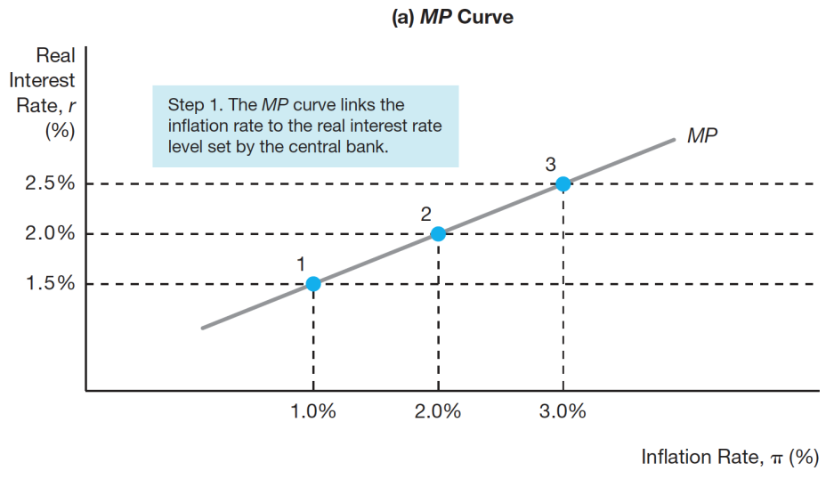
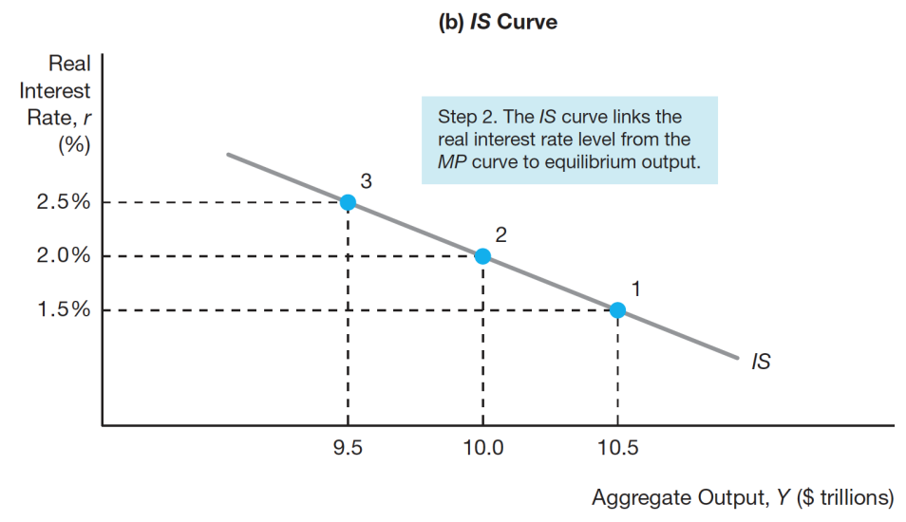
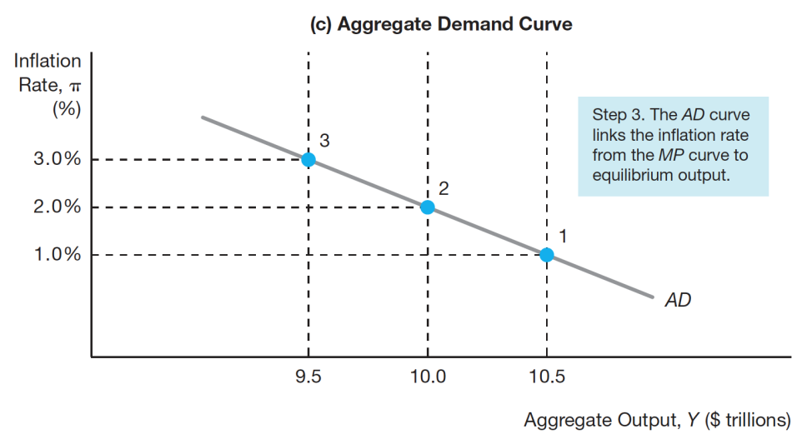
Figure 4 Deriving the AD Curve

Slide 14
Factors That Shift the Aggregate Demand Curve
Shifts in the IS curve
Autonomous consumption expenditure
Autonomous investment spending
Government purchases
Taxes
Autonomous net exports
Any factor that shifts the IS curve shifts the aggregate demand curve in the same direction.

Slide 15
Deriving the AD Curve Algebraically
Combining the IS and MP curves:
IS : $Y=\left[\overline{C}+\overline{I}−d\overline{f}+\overline{G}+\overline{NX}−mpc∙\overline{T}\right]×\frac{1}{1−mpc}−\frac{d+x}{1−mpc}×r$
MP: $r=\overline{r}+λπ$
Algebraic manipulation gives the AD curve:
$Y=\left[\overline{C}+\overline{I}−d\overline{f}+\overline{G}+\overline{NX}−mpc∙\overline{T}\right]×\frac{1}{1−mpc} − \frac{d+x}{1−mpc}×\left(\overline{r}+λπ\right)$
What factors affect the slope of the aggregate demand curve?

Slide 16
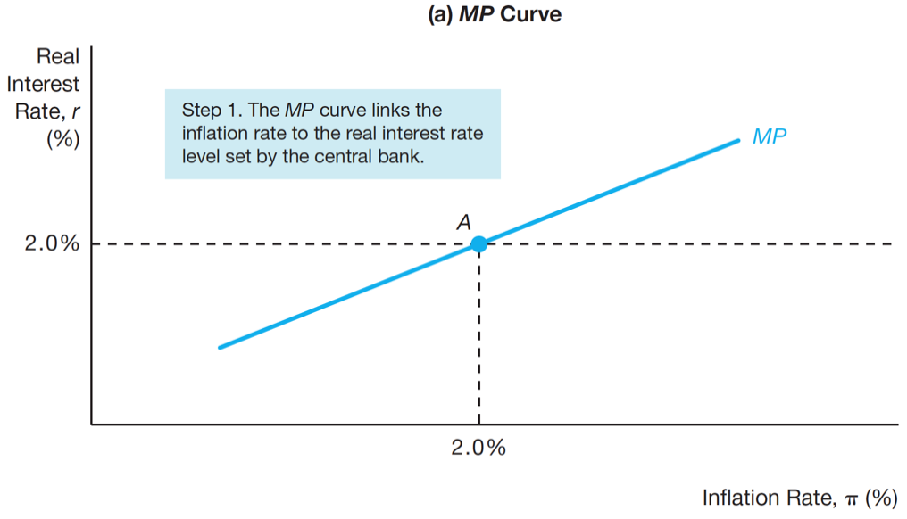
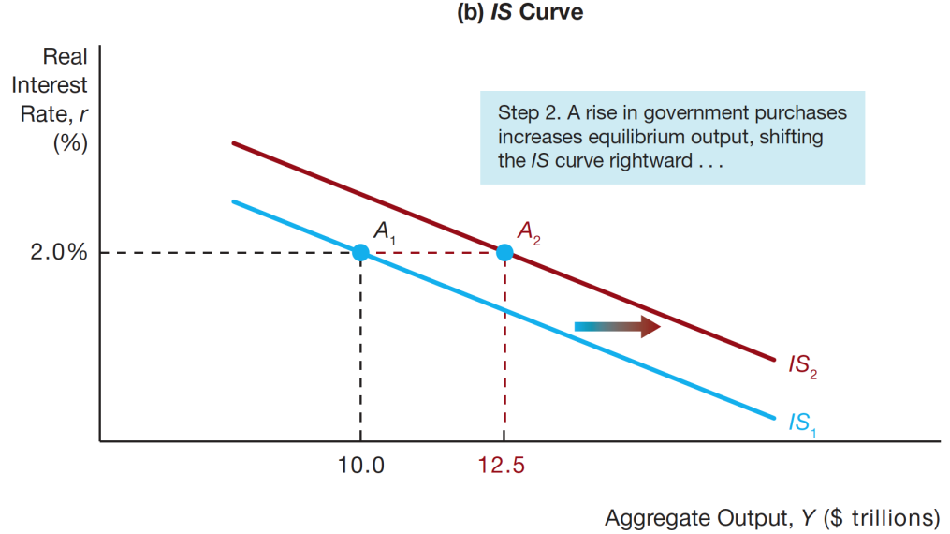
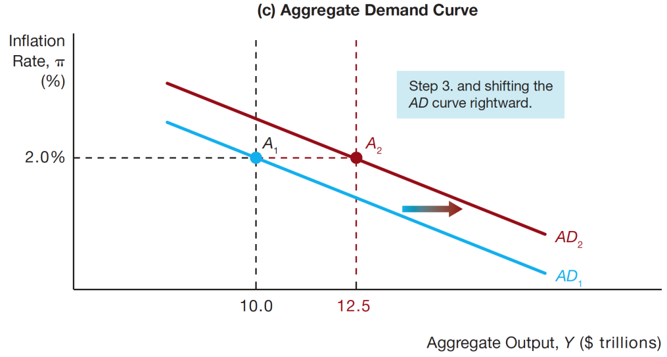
Figure 5 Shift in the AD Curve from Shifts in the IS Curve

Slide 17
Factors That Shift the Aggregate Demand Curve
Shifts in the MP curve
An autonomous tightening of monetary policy, that is a rise in real interest rate at any given inflation rate, shifts the aggregate demand curve to the left
Similarly, an autonomous easing of monetary policy shifts the aggregate demand curve to the right

Slide 18
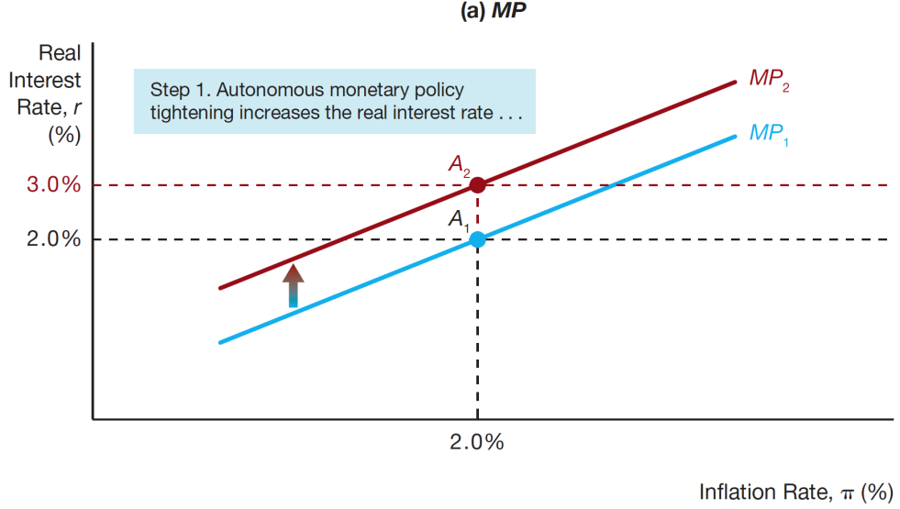
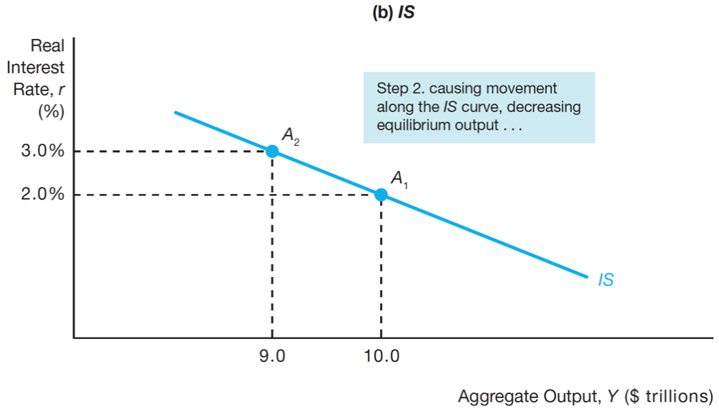
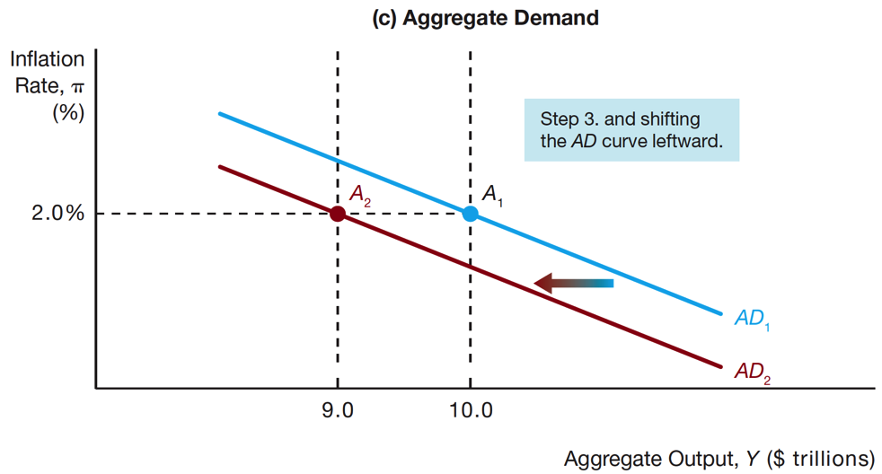
Figure 6 Shift in the AD Curve from Autonomous Monetary Policy Tightening

