Slide 1
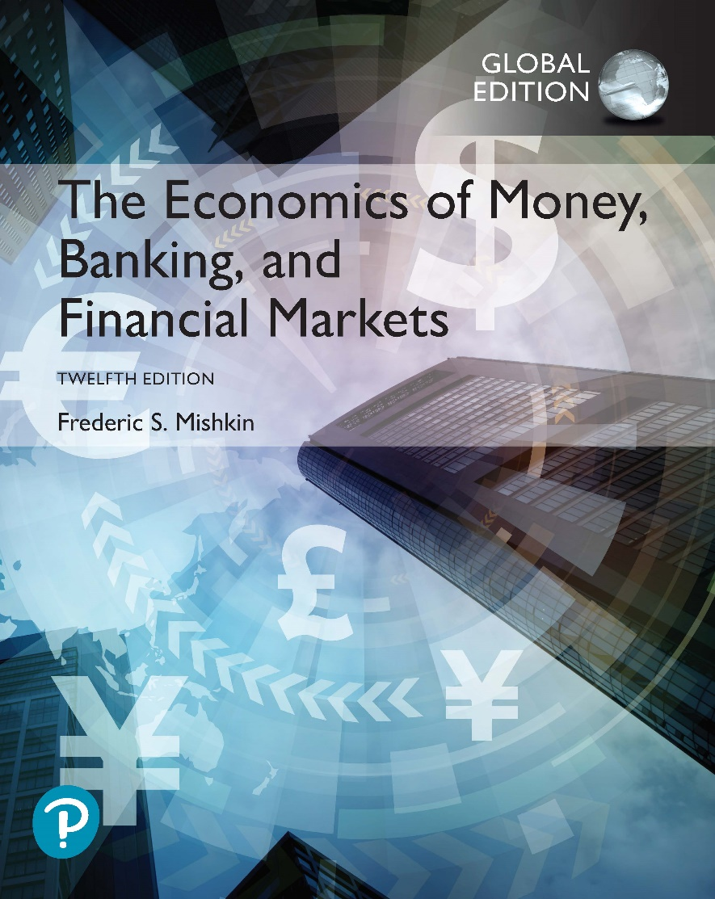
The Economics of Money, Banking, and Financial Markets
Twelfth Edition, Global Edition
Chapter 13
Financial Crises in Emerging Economies
Copyright © 2019 Pearson Education, Ltd.
Notes:
If this PowerPoint presentation contains mathematical equations, you may need to check that your computer has the following installed:
1) MathType Plugin
2) Math Player (free versions available)
3) NVDA Reader (free versions available)

Slide 2
Preview
This chapter applies the asymmetric information theory of financial crises to investigate the cause of frequent and devastating financial crises in emerging market economies
This analysis is then applied to the events surrounding the financial crises that took place in South Korea and Argentina in recent years and explore why these events caused such devastating contractions of economic activity.

Slide 3
Dynamics of Financial Crisis in Emerging Market Economies (1 of 5)
Stage one: Initial Phase
Path A: Credit Boom and Bust
Weak supervision and lack of expertise lead to a lending boom.
Domestic banks borrow from foreign banks.
Fixed exchange rates give a sense of lower risk.
Banks play a more important role in emerging market economies, since securities markets are not well developed yet.
At this stage emerging economies may report “sound fundamentals.” For example, fiscal positions may be sound.
Credit boom is associated with deteriorating balance of payments.

Slide 4
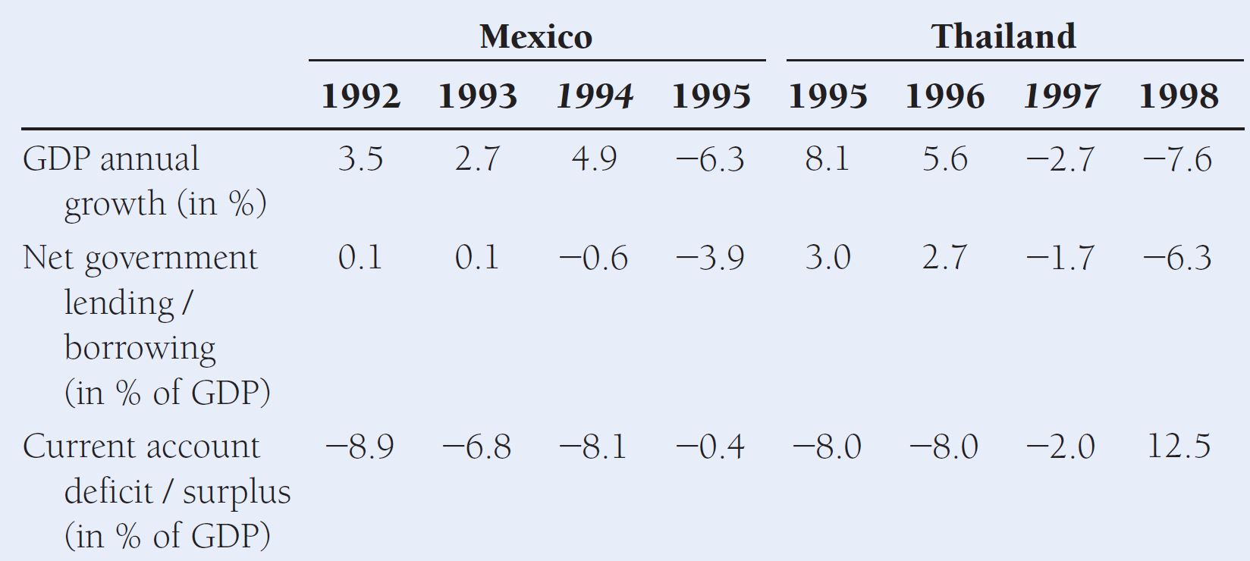
Key Economic Indicators for Crisis-Stricken Mexico and Thailand
Source: Adapted from International Monetary Fund. World Economic Outlook Database. www.imfstatistics.org/imf/
Crisis years are indicated in italics.

Slide 5
Dynamics of Financial Crisis in Emerging Market Economies (2 of 5)
Stage one: Initial Phase
Path B: Severe Fiscal Imbalances
Governments in need of funds sometimes force banks to buy government debt.
When government debt loses value, banks lose and their net worth decreases.
Additional factors:
Increase in interest rates (from abroad)
Asset price
Decrease firms' net worth and thus increase adverse selection problems
Uncertainty linked to unstable political systems

Slide 6
Dynamics of Financial Crisis in Emerging Market Economies (3 of 5)
Stage two: Currency Crisis
Deterioration of bank balance sheets triggers currency crises:
Government cannot raise interest rates (doing so forces banks into insolvency)…
… and speculators expect a devaluation.
Note difference with advanced economies (where bank failures do not cause currency crisis)
Severe fiscal imbalances triggers currency crises:
Foreign and domestic investors sell the domestic currency.

Slide 7
Dynamics of Financial Crisis in Emerging Market Economies (4 of 5)
Stage three: Full-Fledged Financial Crisis
Currency mismatch: another difference from advanced economies
Arises out of the denomination of many debt contracts in a foreign currency (usually a foreign reserve currency such as the US$)
At the same time, however, domestic income denominated in local currency
With currency crisis, firms face a higher debt
Net worth decreases and averse selection problems increases

Slide 8
Dynamics of Financial Crisis in Emerging Market Economies (5 of 5)
Stage three: Full-Fledged Financial Crisis
Debt burden in terms of domestic currency increases (net worth decreases).
Increase in expected and actual inflation reduces firms’ cash flow.
“Twin crisis”
Banks are more likely to fail:
Individuals are less likely to payoff debts (value of assets fall)
Debt denominated in foreign currency increases (value of liabilities increase)

Slide 9
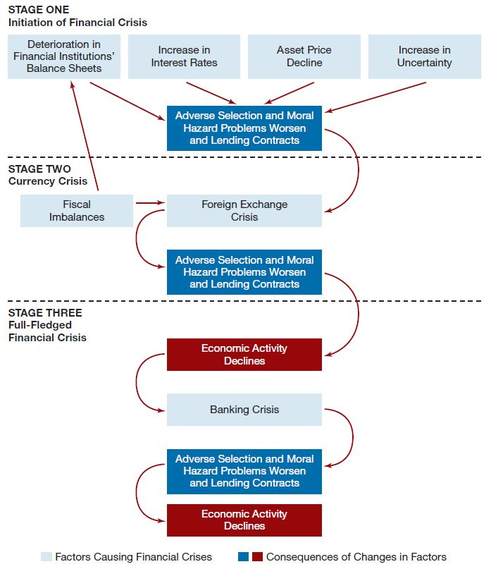
Figure 1 Sequence of Events in Emerging Market Financial Crises

Slide 10
Application: Crisis in South Korea, 1997–98 (1 of 5)
Financial liberalization and globalization mismanaged
Perversion of the financial liberalization and globalization process: chaebols and the South Korean crisis
Starting point: sound macroeconomic fundamentals
Rapid growth, low unemployment, and fiscal surpluses
“Asian miracle”

Slide 11
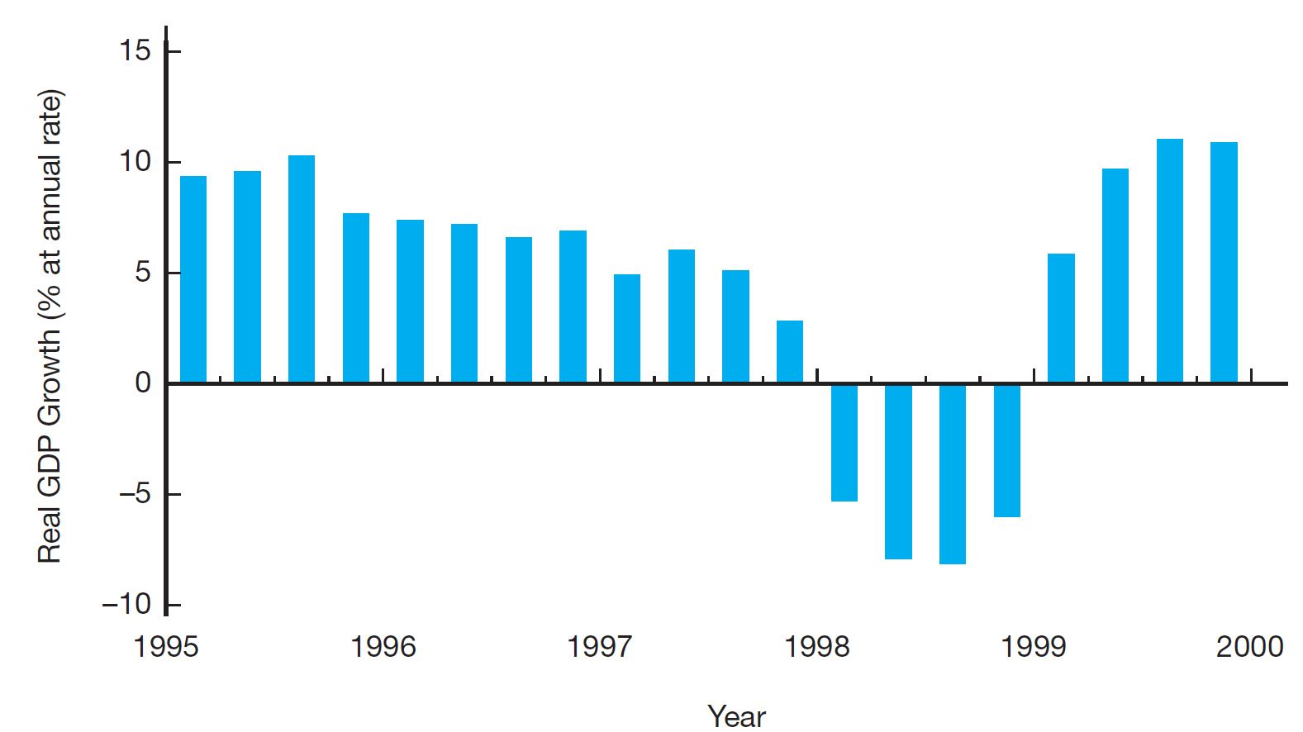
Figure 3 Real GDP Growth, South Korea, 1995–1999
Source: Adapted from International Monetary Fund’s International Financial Statistics, www.imfstatistics.org/imf/

Slide 12
Application: Crisis in South Korea, 1997–98 (2 of 5)
What happened? Financial liberalization in the 1990s
Financial de-regulation
Opening up of capital markets
Outcome: lending boom fueled by massive foreign borrowing - especially short term
Perversion of the financial liberalization and globalization process: chaebols and the South Korean crisis
Chaebols: large family-owned conglomerates
Political ties: too big to fail
Leading role in borrowing frenzy: very high leverage (but low profits)
Facilitating role played by South Korean merchant banks

Slide 13
Application: Crisis in South Korea, 1997–98 (3 of 5)
Stock market decline and failure of firms increase uncertainty
In early 1997, series of negative shocks to the external position of (already weakened) chaebols
First high-profile bankruptcy of one of the largest chaebols in January, followed by 5 more
Uncertainty caused by such bankruptcies, and decrease in chaebols' net worth, cause a sharp decline in stock market values
Adverse selection and moral hazard problems worsen, and the economy contracts

Slide 14
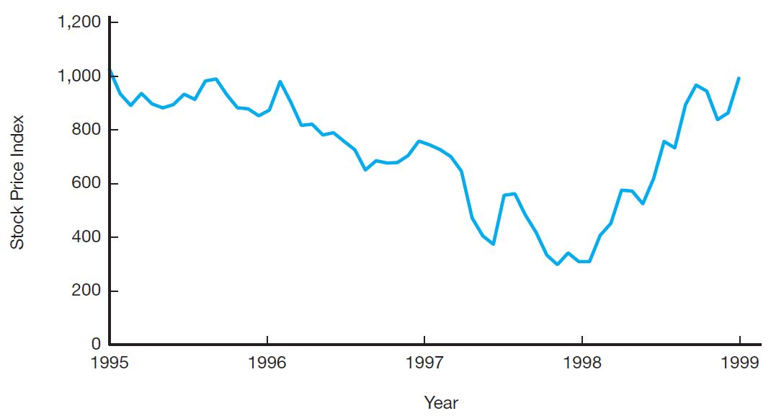
Figure 5 Stock Market Index, South Korea, 1995–1999
Source: Global Financial Data, available at www.globalfinancialdata.com/.

Slide 15
Application: Crisis in South Korea, 1997–98 (4 of 5)
Currency crisis ensues
Speculative attack against the South Korean currency (won)
Fueled by
deterioration financial health of chaebols (associated with high leverage)
crisis of confidence affecting other Southeast Asian economies
Final stage: currency crisis triggers full-fledged financial crisis
50% decrease in value of the won increases the value of foreign debt by 50%
Increased adverse selection & moral hazard
Deterioration of banks' balance sheets
GDP declines by 6%

Slide 16
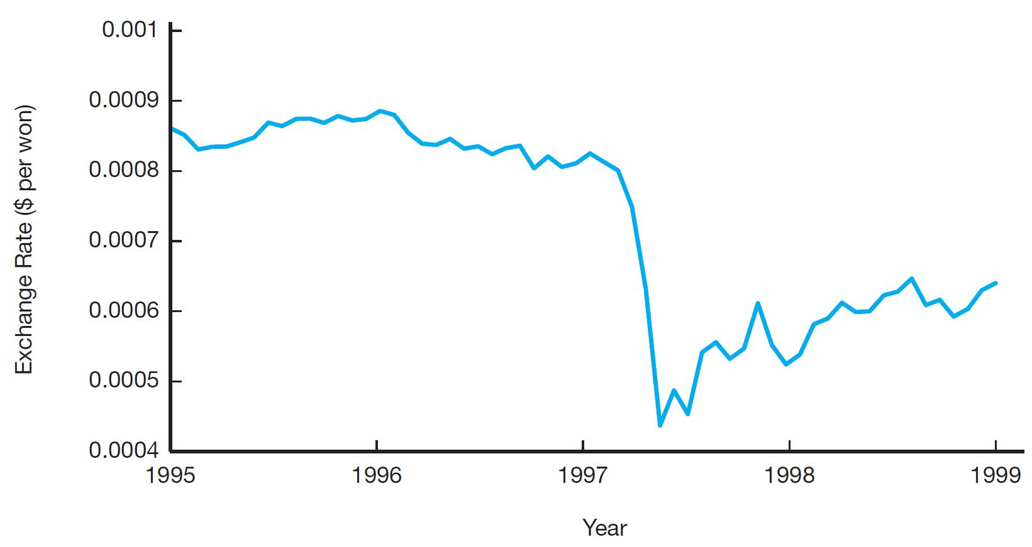
Figure 6 Value of South Korean Currency, 1995–1999
Source: Adapted from International Monetary Fund’s International Financial Statistics, www.imfstatistics.org/imf/

Slide 17
Application: Crisis in South Korea, 1997–98 (5 of 5)
Economic impact of the crisis
Declining GDP causes a sharp increase in unemployment
Inflation increases spurred by increases in import prices
Central bank increases interest rates...
...Which worsen the balance sheet of banks and firms
Severe socio-economic consequences
Recovery
Aggressive policy by South Korean government to restore financial stability
In particular, overhaul of financial regulation
Financial markets stabilize in 1998–99.

Slide 18
Global: China and the “Noncrisis” in 1997–1998
China not affected by the 1997-98 crisis in East Asia. Why?
Two key factors:
Slower, more restricted financial liberalization in China
No currency instability
Renminbi pegged to the dollar and not convertible for capital account transactions
Impact of the crisis on China's subsequent economic policies
Vindicated the policy of “controlled liberalization”
Encouraged the country to accumulate foreign exchange reserves

Slide 19
Application: The Argentine Financial Crisis, 2001–2002 (1 of 6)
Severe fiscal imbalances
Adverse selection and moral hazard problems worsen
Bank panic begins
Currency crisis ensues
Currency crisis triggers full-fledged financial crisis
Recovery begins

Slide 20
Application: The Argentine Financial Crisis, 2001–2002 (2 of 6)
Severe fiscal imbalances
Contrast with Mexico (1995) and East Asian crisis (1997)
No lending boom, banks had sounder balance sheets
However, growing fiscal imbalances led the government to ask banks to buy public debt
Bank balance sheets deteriorate, while investors (foreign and domestic) do not regain trust in Argentina's ability to repay debt

Slide 21
Application: The Argentine Financial Crisis, 2001–2002 (3 of 6)
Adverse selection and moral hazard problems worsen
By 2001, banks start losing deposits and reduce lending
Increases in adverse selection and moral hazards
Bank panic begins
Doubts over sustainability of fiscal imbalances grow throughout 2001
By October, default becomes real prospect
Investors lose trust in banks
In November, deposit withdrawals reach US$1 billion/day
Restrictions on withdrawals imposed by government fan the flames of social unrest–30 die in violent riots

Slide 22
Application: The Argentine Financial Crisis, 2001–2002 (4 of 6)
Currency crisis ensues
At the time of the bank panic, currency board was in place
Currency board: Arrangement in which the Argentine government fixed the value of one Argentine peso to one U.S. dollar by agreeing to buy and sell pesos at that exchange rate
But bank panic clearly questions the ability of the government to keep interest rates high to preserve the currency board
Speculative attacks against the peso multiply
In December, 2001, the government announces the suspension of external debt repayments
In January 2002, the government announces the end of the currency board

Slide 23
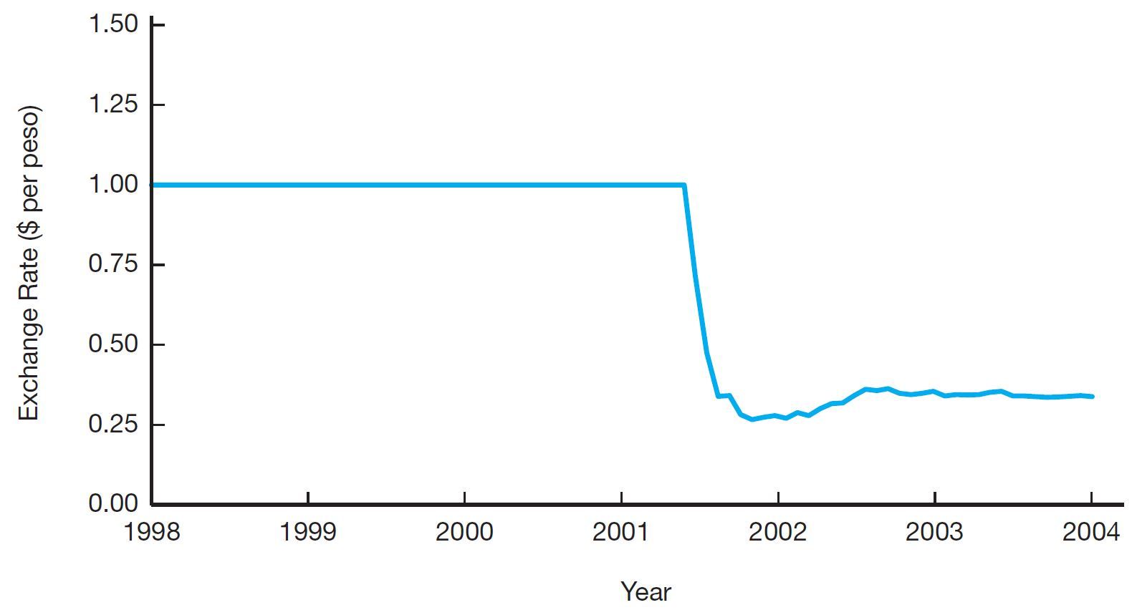
Figure 9 Argentine Peso, 1998–2004
Source: Adapted from International Monetary Fund’s International Financial Statistics, www.imfstatistics.org/imf/

Slide 24
Application: The Argentine Financial Crisis, 2001–2002 (5 of 6)
Currency crisis triggers full-fledged financial crisis
Free fall of the peso, stabilizing at 25% of its value by the end of 2001
Rapid increase in capital outflows and decline in lending
Increase in inflation through higher import prices (like in South Korea), compounded by historically poor inflation performance in the country
GDP decreases, dramatic increases in unemployment and poverty
Worst crisis in Argentina's history

Slide 25
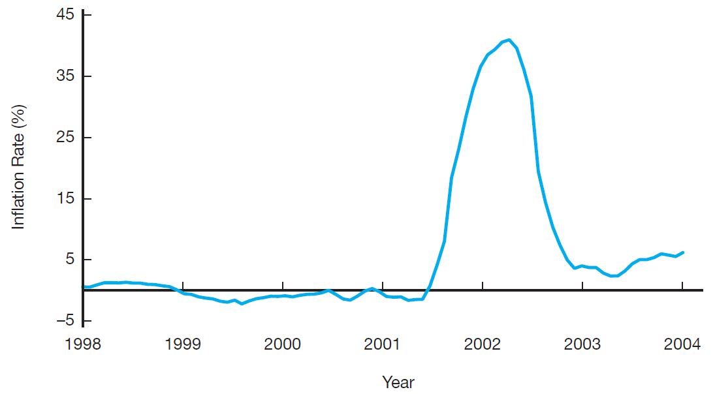
Figure 10 Inflation in Argentina, 1998–2004
Source: Adapted from International Monetary Fund’s International Financial Statistics, www.imfstatistics.org/imf/

Slide 26
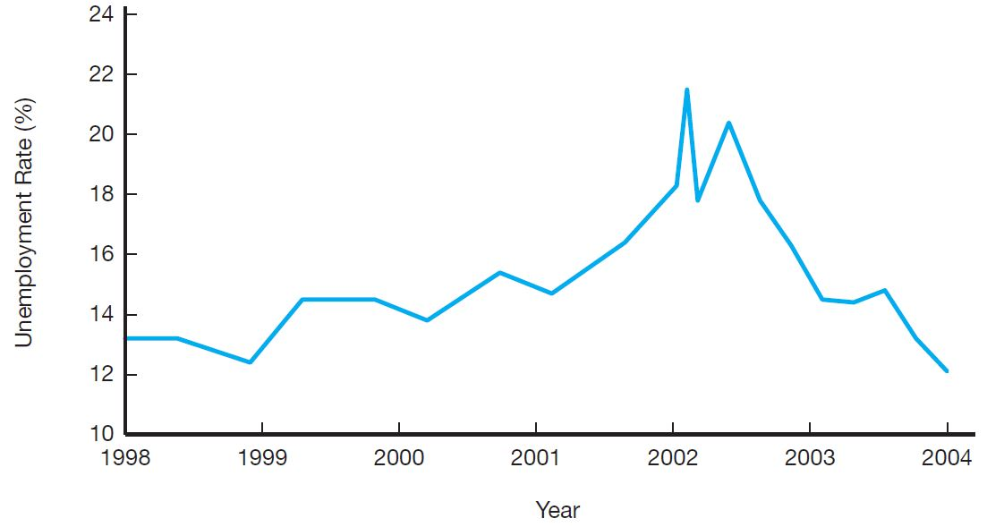
Figure 12 Unemployment Rate, Argentina, 1998–2004
Source: Adapted from Global Financial Data, available at www.globalfinancialdata.com/.

Slide 27
Application: The Argentine Financial Crisis, 2001–2002 (6 of 6)
Recovery begins
Financial recovery in 2002 together with boom in demand for Argentinian exports
Growth resumes at fast pace in 2003: +10% annual rate

Slide 28
Global: When an Advanced Economy Is Like an Emerging Market Economy: The Icelandic Financial Crisis of 2008
The financial crisis and economic contraction in Iceland that started in 2008 followed the script of a financial crisis in an emerging market economy, even though Iceland is a wealthy nation.
Financial liberalization led to rising stock market values and currency mismatch.
Foreign capital fled the country as a severe recession developed.

Slide 29
Preventing Emerging Market Financial Crises
Beef up prudential regulation and supervision of banks
Encourage disclosure and market-based discipline
Limit currency mismatch
Sequence financial liberalization

