Slide 1
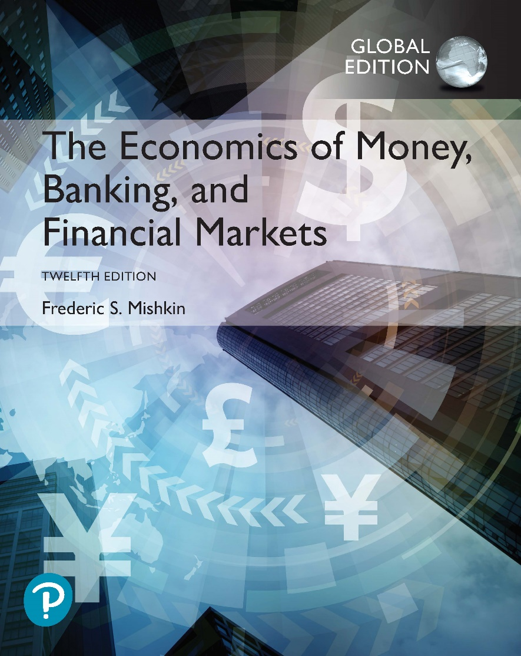
The Economics of Money, Banking, and Financial Markets
Twelfth Edition, Global Edition
Chapter 21
The IS Curve
Copyright © 2019 Pearson Education, Ltd.
Notes:
If this PowerPoint presentation contains mathematical equations, you may need to check that your computer has the following installed:
1) MathType Plugin
2) Math Player (free versions available)
3) NVDA Reader (free versions available)

Slide 2
Preview
This chapter develops the IS schedule, which describes the relationship between real interest rates and aggregate output when the market for real goods and services is in equilibrium.

Slide 3
Learning Objectives
List the four components of aggregate demand (or planned expenditure).
List and describe the factors that determine the four components of aggregate demand (or planned expenditure).
Solve for the goods market equilibrium.
Describe why the IS curve slopes downward and why the economy heads to a goods market equilibrium.
List the factors that shift the IS curve and describe how they shift the IS curve.

Slide 4
Planned Expenditure and Aggregate Demand (1 of 2)
Planned expenditure is the total amount of spending on domestically produced goods and services that households, businesses, the government, and foreigners want to make.
Aggregate demand is the total amount of output demanded in the economy.

Slide 5
Planned Expenditure and Aggregate Demand (2 of 2)
The total quantity demanded of an economy’s output is the sum of 4 types of spending:
Consumption expenditure (C)
Planned investment spending (I)
Government purchases (G)
Net exports (NX)

Slide 6
The Components of Aggregate Demand
In Keynes’ view, consumption expenditure is positively related to disposable income, which is available for spending:
$$Y_{D}=Y−T$$
The consumption function can be expressed as
$$C=\overline{C}+mpc×Y_{D}=\overline{C}+mpc(Y−T)$$
$\overline{C}$ : autonomous consumption expenditure
$mpc$ : marginal propensity to consume, which is a constant between 0 and 1.

Slide 7
Investment Spending
Fixed investment are always planned.
Inventory investment can be unplanned.
Planned investment spending
Interest rates
Expectations

Slide 8
Planned Investment Spending
Investment function (fixed investment plus planned inventory investment)
$I=\overline{I}−d∙r_{i}$
$\overline{I}$ : autonomous investment
$d$ : responsiveness of investment to real interest rate
The real interest rates on investment is subject to financial frictions ($\overline{f}$) that hinder the efficient functioning of financial markets
$$r_{i}=r+\overline{f}$$

Slide 9
Net Exports
Two components: autonomous net exports and the part of net exports that is affected by changes in real interest rates
Net export function:
$$NX=\overline{NX}−xr$$

Slide 10
Government Purchases and Taxes
The government affects aggregate demand in two ways: through its purchases and taxes
Government purchases:
$$G=\overline{G}$$
Government taxes:
$$T=\overline{T}$$

Slide 11
Goods Market Equilibrium (1/2)
Keynes recognized that equilibrium would occur in the economy when the total quantity of output produced in the economy equals the total amount of aggregate demand (planned expenditure).
Solving for goods market equilibrium:
Aggregate Output ($Y$) = Consumption Expenditure ($C$) + Planned Investment Spending ($I$) + Government Purchases ($G$) + Net Exports ($NX$)

Slide 12
Goods Market Equilibrium (2/2)

Slide 13
Understanding the IS Curve
What the IS curve tells us: traces out the points at which the goods market is in equilibrium
Examines an equilibrium where aggregate output equals aggregate demand
Assumes fixed price level where nominal and real quantities are the same
IS curve is the relationship between equilibrium aggregate output and the interest rate.

Slide 14
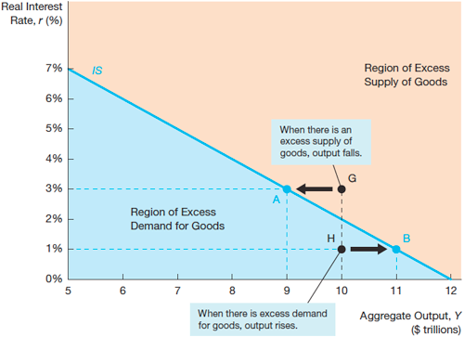
Figure 1 The IS Curve

Slide 15
Why the Economy Heads Toward the Equilibrium
Interest rates and planned investment spending
Negative relationship
Interest rates and net exports
Negative relationship
IS curve: the points at which the total quantity of goods produced equals the total quantity of goods demanded
Output tends to move toward points on the curve that satisfies the goods market equilibrium.

Slide 16
Factors That Shift the IS Curve (1 of 3)
The IS curve shifts whenever there is a change in autonomous factors (factors independent of aggregate output and the real interest rate).
One example is changes in government purchases, as in Figure 2.

Slide 17
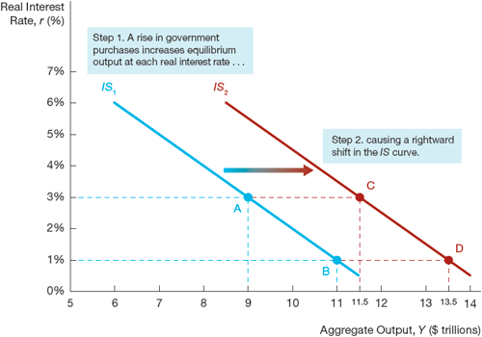
Figure 2 Shift in the IS Curve from an Increase in Government Purchases

Slide 18
Application: The Vietnam War Buildup, 1964–1969
The United States’ involvement in Vietnam began to escalate in the early 1960s.
Usually during a period when government purchases are rising rapidly, central banks raise real interest rates to keep the economy from overheating.
The Vietnam War period, however, is unusual because the Federal Reserve decided to keep real interest rates constant. Hence, this period provides an excellent example of how policy makers could make use of the IS curve analysis to inform policy.

Slide 19
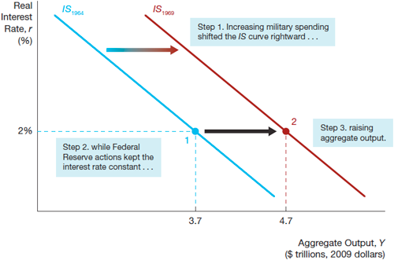
Figure 3 Vietnam War Build Up

Slide 20
Changes in Taxes
At any given real interest rate, a rise in taxes causes aggregate demand and hence equilibrium output to fall, thereby shifting the IS curve to the left.
Conversely, a cut in taxes at any given real interest rate increases disposable income and causes aggregate demand and equilibrium output to rise, shifting the IS curve to the right.

Slide 21
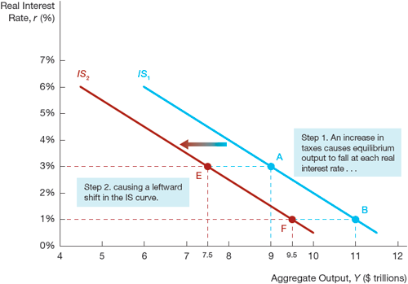
Figure 4 Shift in the IS Curve from an Increase in Taxes
Another example of what shifts the IS curve is changes in taxes, as in Figure 4

Slide 22
Application: The Fiscal Stimulus Package of 2009 (1 of 2)
In the fall of 2008, the U.S. economy was in crisis. By the time the new Obama administration had taken office, the unemployment rate had risen from 4.7% just before the recession began in December 2007 to 7.6% in January 2009.
To stimulate the economy, the Obama administration proposed a fiscal stimulus package that, when passed by Congress, included $288 billion in tax cuts for households and businesses and $499 billion in increased federal spending, including transfer payments.

Slide 23
Application: The Fiscal Stimulus Package of 2009 (2 of 2)
These tax cuts and spending increases were predicted to increase aggregate demand, thereby raising the equilibrium level of aggregate output at any given real interest rate and so shifting the IS curve to the right.
Unfortunately, most of the government purchases did not kick in until after 2010, while the decline in autonomous consumption and investment was much larger than anticipated.
The fiscal stimulus was more than offset by weak consumption and investment, with the result that the aggregate demand ended up contracting rather than rising, and the IS curve did not shift to the right, as hoped.

Slide 24
Factors That Shift the IS Curve (2 of 3)
Changes in autonomous spending also affect the IS curve:
Autonomous consumption
Autonomous investment spending
Autonomous net exports

Slide 25
Autonomous Consumption
A rise in autonomous consumption would raise aggregate demand and equilibrium output at any given interest rate, shifting the IS curve to the right.
Conversely, a decline in autonomous consumption expenditure causes aggregate demand and equilibrium output to fall, shifting the IS curve to the left.

Slide 26
Autonomous Investment Spending
An increase in autonomous investment spending increases equilibrium output at any given interest rate, shifting the IS curve to the right.
On the other hand, a decrease in autonomous investment spending causes aggregate demand and equilibrium output to fall, shifting the IS curve to the left.

Slide 27
Autonomous Net Exports
An autonomous increase in net exports leads to an increase in equilibrium output at any given interest rate and shifts the IS curve to the right.
Conversely, an autonomous fall in net exports causes aggregate demand and equilibrium output to decline, shifting the IS curve to the left.

Slide 28
Factors That Shift the IS Curve (3 of 3)
Another factor that shifts the IS curve is changes in financial frictions
An increase in financial frictions, as occurred during the financial crisis of 2007–2009, raises the real cost of borrowing to firms and hence causes investment spending and aggregate demand to fall

Slide 29
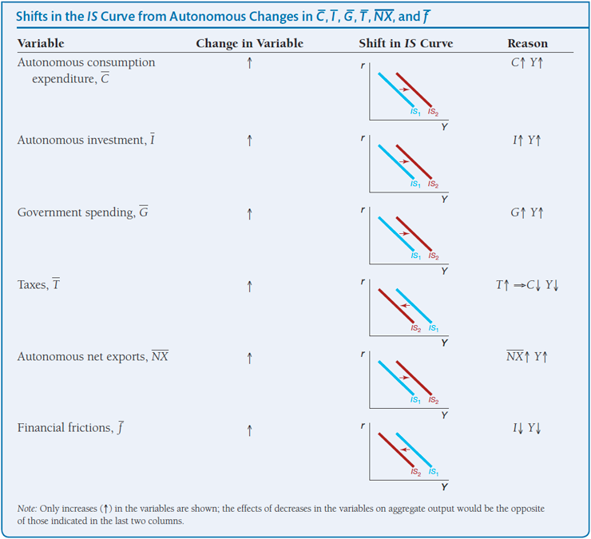
Summary Table 1 Shifts in the IS Curve from Autonomous Changes in C̅, I̅, G̅, T̅, N̅X̅ and f̅

